Slide 1
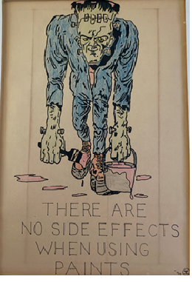
Introducing Risk Assessment and Management
For Protecting People and Reducing Risks
Dr. Bob Rajan OBE JP PhD
Please read slide notes where provided
Notes:
The artwork on this slide was given to me as a present.
It was for saying that “I will not undertake air monitoring. I do not consider it as the priority, where as exposure control measures are. Put them in place, then we think about air monitoring.”
Most highly durable paints applied to high performance systems contain a number toxic solvents and metals. Exposure to these solvents can affect our nervous system and brain.

Slide 2
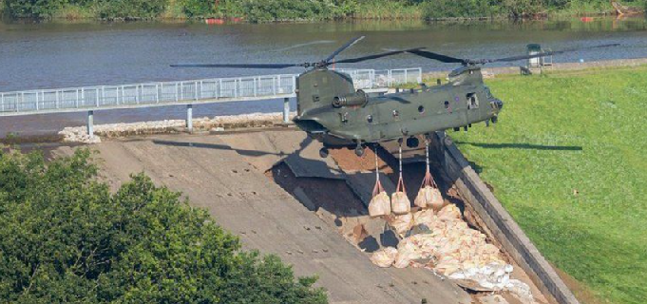
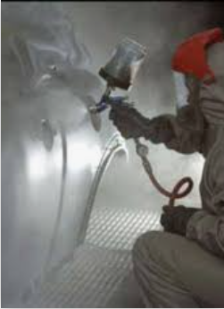
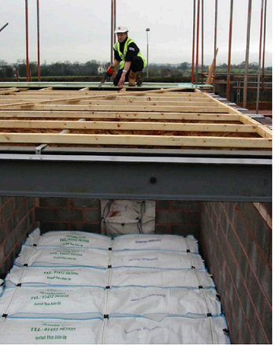
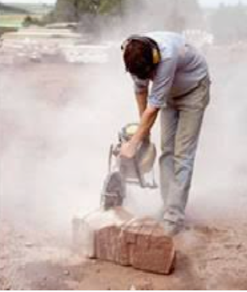
Be a sport,
spot
Hazards
Hazardous events or conditions
Risks
Precautions taken / in place / needed
Notes:
In this presentation, we are going to introduce key terms that you will come across, use, and apply during your study at the college and in your working years.
Hazard, Hazardous event or condition, Risk, Risk assessment, and Risk management.
You need to be familiar with these so that you can apply them effectively to look after yourself and others around you at work.
LOcHER Hands On:
Please use these pictures to spot hazards, hazardous events or conditions, risks and precautions or control measures taken or should be taken to reduce risks.
You are not expected to spot everything accurately right now. This presentation will give you more knowledge and experience to be good at it.
Don’t be Risk Averse Manage Risks Be Save and Healthy

Slide 3
Tutors notes for slide 2
Whaley Bridge Dam
Hazard: the power stored in the water (hydrostatic energy) behind the dam. Source of hazard: millions of tons of water. Control measure: dam and spillway.
Hazardous condition: damage to the dam structure, causing weakness in control defence (measure). Damaged caused by heavy rain, underpinned by poor design, lack of adequate testing and maintenance of the dam. Temporary defence boost (control) to prevent a catastrophic failure: adding sand bags and concreate; then controlled draining of the power (water) to enable detailed inspection and repair. Risk: damage to properties and danger to life (in the way of the surging water). How likely is the harm (exposure to surging water): very likely; How serious the harm: extremely serious with potential for fatal loss of many people.
Working on roof construction
Hazard: falling from height; Source of the hazard: roof in construction and the spaces in it. Hazardous event/condition: loosing the balance from the siting condition (by overreaching or slipping). Risk: falling (highly likely, based on previous experience); Harm and seriousness: personal injury- very serious, fatality most likely. Control measures: Air cushion for soft-landing in case of a fall, seating arrangement to do the job, helmet; industrial shoes with good grip and angle protection. Take a note: the potential for falling has not been eliminated because the open spaces between beams remain. Control measure is reducing seriousness of the risk.
The other two examples: dealt with in slides 15 and 16.
Notes:
No Notes

Slide 4
Hazard:
What could cause harm - an injury, illness, damage or fatalities.
Something that has the potential or is likely to cause harm to people or property.
In this example: The corrosive property of the liquid in test tubes.
The source of the hazard is the liquid in test tubes.
Notes:
No Notes

Slide 5
Hazardous Event/Condition/Situation
Hazardous event: a situation/event/condition that can lead to exposure and risk
Here: Corrosive liquid being spilt from the test tubes
Notes:
No Notes

Slide 6
Risk
Risk: How likely it is that someone/something could be harmed and how seriously
How likely that the spilt corrosive liquid may get on to the skin of a worker’s hands (exposure) to cause burns and how serious those burns can be
Notes:
No Notes

Slide 7
Risk Assessment
Hazard: what could cause injury, illness, damage
Corrosive property of the liquid in the test tube
Hazardous event: a situation that can lead to risk
Corrosive liquid being spilt from test tubes
Risk: likely it is that someone/something could be harmed (by exposure) and how seriously
How likely that the corrosive liquid may get on to the skin of a worker’s hands (exposure) and cause burns and how serious those burns can be
Decide on Exposure Controls for preventing or Reducing Risks
Notes:
LOcHER Hands on:
1. If the event used on this hazard sign takes place for real at a workplace, what precautions will you put in place to prevent or reduce the risk of skin burns? This is an artificial scenario, so be adventurous to come up with answers, they do not have to be accurate.
2. List the types of control measures used at a task in your work area and find out what was (were) the reason(s) for using the said control measures.

Slide 8
HSE - 5 Steps to Managing Risks
Identify hazards
Assess the risks
Control the risks
Record your findings
Review the controls
Notes:
The links on the slide will take you to HSE website where detailed explanation is provided for you. But, most of it is summarised in this presentation, making it easy for you.

Slide 9
Risk Assessment and Management
https://youtu.be/xyANahuhGs0
Notes:
No Notes

Slide 10
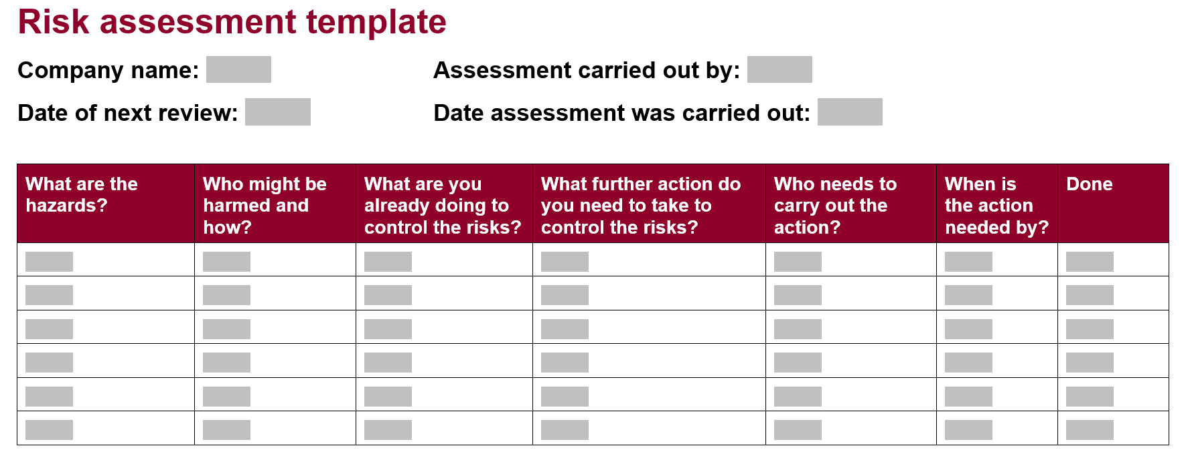
Risk assessment: Template and examples - HSE
Notes:
Have you noticed that HSE has made it simple for small companies and for you to do course work presentations.

Slide 11
Examples
Notes:
LOcHER Hands On:
Use the template, do a risk assessment on a task in your work area and use it in your course work submission.
You may update your risk assessment after reading this
whole presentation. You will learn new tricks which should help to achieve good grades.

Slide 12
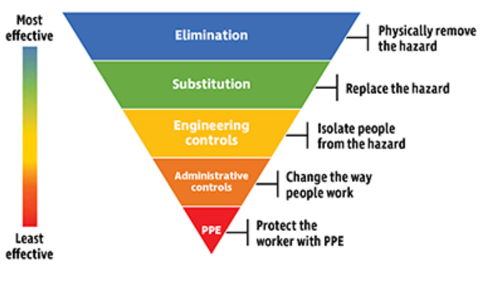
Law demands that employer must apply Hierarchy of Controls
Notes:
LOcHER Hands on:
Why PPE is considered as least effective when it is compared with engineering controls.
Use the arguments in you course work assessment
PPE is the least effective way to protect workers from workplace hazards because if the equipment is not selected correctly, not worn correctly, not used correctly, not maintained and fails in any way, workers will be exposed to the hazard.

Slide 13
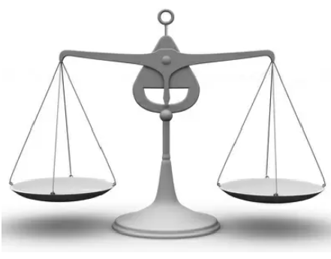
Law demands that employer must apply Hierarchy of Controls but take account of reasonably practicability
Time,
Trouble,
Cost, Technical difficulty
Severity of the risk
Notes:
HSE does not always demand elimination or substitution of the hazard.
They will consider the factors on the right pan of the scale against the severity of the hazard to cause the harm and the likely extent of the harm. They will refer to industry standards and HSE guidance in place for providing advice to industry for controlling a specific hazard.
They will expect your employer to apply them or use other measures which are equally valid.
If the risks aren’t adequately controlled, HSE inspectors are likely to take enforcement actions which are appropriate to the situation in hand.

Slide 14
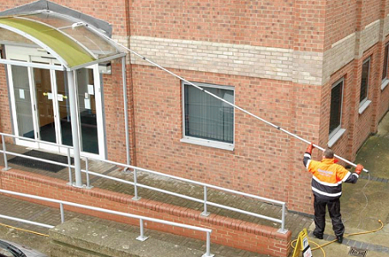
Example - Physically Removing the Hazard
Hazard: Working at height
Source: Ladder
Hazardous events: Falling from a ladder, over reaching, wet rungs, low grip as one hand is doing the work
Who will be harmed: Window cleaners
How likely: Likely, based on previous accidents data, publicity
Harm: Serious bodily injury or fatal injury
Control measures: No ladders, no working at height (Elimination). Working at ground level with using alternative method and equipment
Notes:
Some may argue that pushing and pulling of the cleaning rod could cause manual handing risks.
Which one is the least happy option: climbing up and down a ladder, carrying a ladder, using just one hand to grip the the ladder, if a fall takes place - being fatally or seriously injured. Making sure the approach for using the rod is appropriate.
Also note, the brush at the end of the rod is soft to reduce friction; water and soap improves the ease of movement. Rod is made from high-quality, high tensile strength plastic.

Slide 15
Example - Controlling Risk
Hazard: Isocyanate (asthmagen)
Hazardous event: Spray painting
Who would be harmed: Sprayers
How likely: Highly likely, based on industry data, safety data sheet and research
Harm: Occupational asthma, a very serious illness
Control measures: High boiling point isocyanates introduced instead of a low boiling point on (substitution),
down draught booth, spray clearance time established, high volume low pressure spray guns used, and more (engineering controls);
Only sprayer allowed in the booth - during spraying, sprayers' trained to lift visor on air fed breathing apparatus after the clearance time has passed, supervision etc (administrative controls),
Air supplied visor with peelable visor protector (PPE).
Notes:
Metallic finish on cars provides shine, durability and a good quality coating.
Previously, isocyanates used were of low boiling points. It meant lots of vapour in the air.
So, high boiling point ones were introduced (substitution). It meant less vapour in the breathing zone of the sprayer. Reduced risks.

Slide 16
Controlling Risk - Exercise (print this slide and answer)
Hazard: Crystalline silica dust
Hazardous event: Dry cutting stones
Who would be harmed:
How likely:
Harm:
Control measures:
CIS54 - Dust control on cut-off saws used for stone or concrete cutting (hse.gov.uk)
Notes:
Use HSE template to help you do the risk assessment exercise. You can refer to CIS54 to help you. Just remember, HSE is a good partner, they produce simple guidance; making it easy to manage risks and protect people at work.
Print this slide and write down your assessment and give it your Tutor for a review.

Slide 17
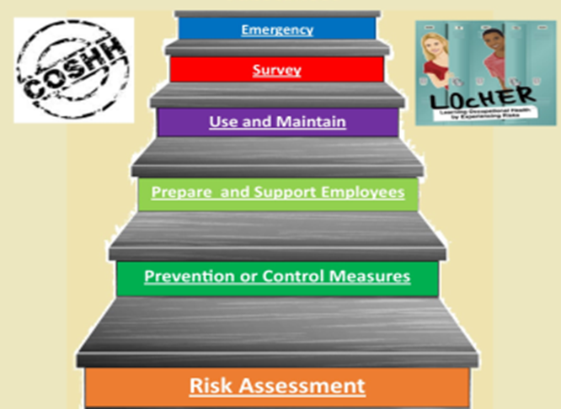
Risk Management
Notes:
This example is for COSHH, but words can be modified to apply to all situations. You would have seen the generalised version in the “General principles of risk assessment/management” presentation. It is provided as poster in this section.

Slide 18
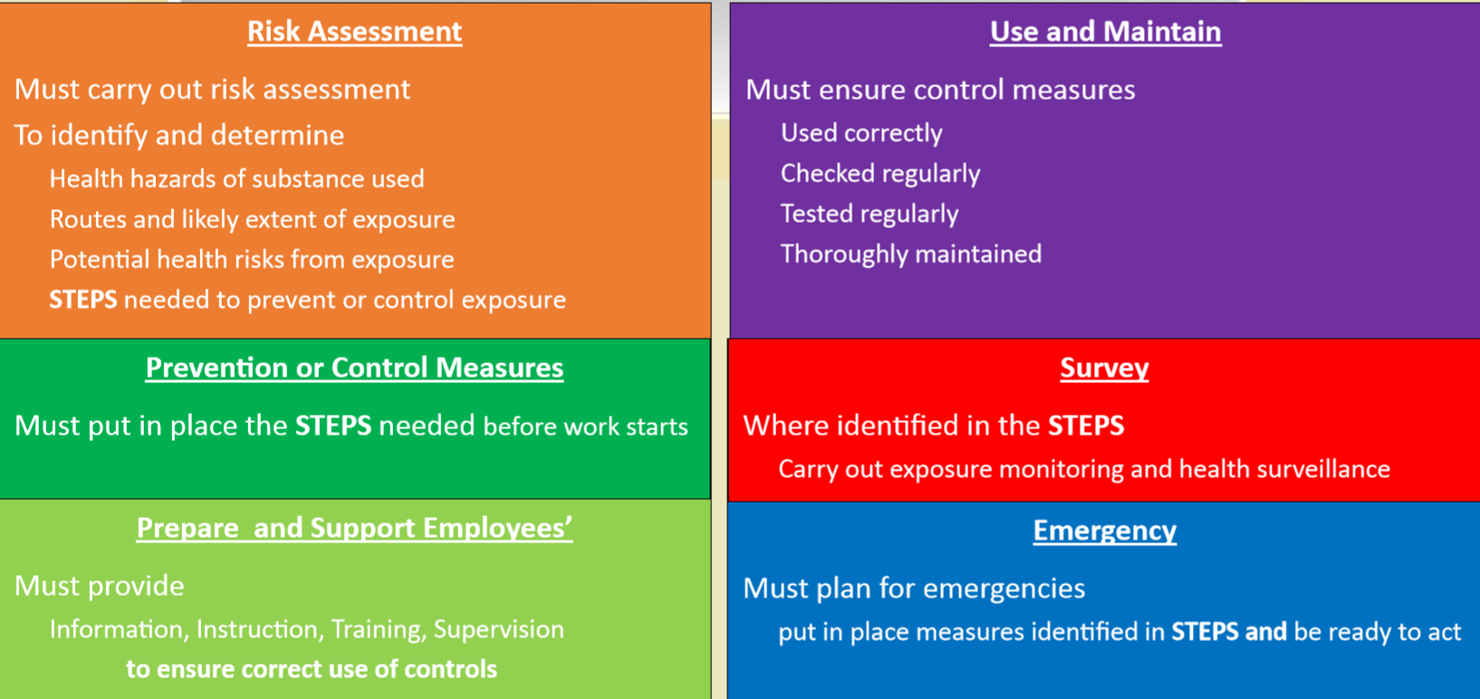
Risk Management
It involves risk assessment and the rest as shown on this slide example
Notes:
You will note that control STEPS identified during risk assessment must be put in place, must work and used correctly to protect employees and others.

Slide 19
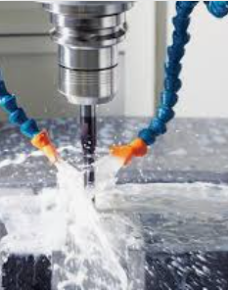
Revision Please print this slide. Answer all questions. Hand it over to your tutor. He/she will consider issuing a SGUK Commendation Certificate.
Which one of these can be considered as describing a hazard? (If not sure, go back and look at slides 3 and 4)
A. A likelihood of an accident taking place.
B. Something that has the potential to cause harm like injury or ill health to someone.
c. Something that has the potential to cause harm like injury to employees only.
d. Tools and cables lying around on the floor area used by pedestrians.
2. Hazards are always obvious to see? (look at slides 14 and 15, if necessary)
Yes ……. No ….
3. Law demands that employers (if not sure revise slides 12 and 13)
Spend as much money to eliminate hazards or risks in the workplace.
Always, eliminate hazards in workplaces, so that no one will be hurt.
When deciding on risk reduction measures consider the hierarchy of controls and apply a balancing act to achieve practical level of controls.
4. Give two examples of mechanical hazards and one for chemical related hazard when undertaking high speed drilling, where cooling of the workpiece is needed.
Mechanicals hazards (think about guarding the drill and metal swarf generated by machining)
Chemical related hazard (think about cooling fluid used)
Notes:
If a rotating drill is not guarded in some ways, it can present a serious risk to the operator due to trapping hazard.
Metal swarf is curly and sharp. They can cause cuts an bruises to the skin.
Sore areas of the skin coming into contact with cooling fluids can cause infection of the damaged area of the skin. Skin exposure to cooling fluids can lead to dermatitis. A quick summary.

Slide 20
Note to Lecturers
For SGUK certificate Word template please contact
contact@safetygroupsuk.org.uk
Notes:
After completing this modular presentation inform your Tutor and you are likely to get a SGUK certificate of commendation.
Your Tutor may ask questions to assess your understanding and application of the knowledge.

Slide 21
Notes:
No Notes for this slide

