Slide 1
Fire Safety
Dr. Bob Rajan OBE JP PhD
Vicechair, SGUK
Read notes where provided
Notes:
The triangle approach is used in many risk assessment situations, here in fire safety.

Slide 2
Fire Safety
Fires need three things to start and sustain:
a source of ignition (heat)
a source of fuel (something that burns), and
oxygen
Notes:
Each area is discussed in the up coming slides.

Slide 3
Fire Safety
Sources of ignition (heat) include:
Heaters
Lighting
Naked flames
Electrical equipment
Smokers' materials (cigarettes, matches etc), and
Anything else that can get very hot or cause sparks
Notes:
Do you recognise one or more of these in your training/practical room?

Slide 4
Fire Safety
Sources of fuel include:
Wood
Paper
Plastic
Rubber
Foam
Loose packaging materials
Waste rubbish
Furniture
Flammable gases
Flammable liquids
Notes:
LOcHER Hands On:
Which one of these are present in your training/practical lab.
If you have wood, in what forms and where.
Thing of others in the same way.
The form is one of the key that can contribute to fire.
Why, debate: – solid wood, fine wood dust; wood shavings; wood soaked in water, wood covered in paint.

Slide 5
Fire Safety
Sources of oxygen include:
The air around us
Oxygen cylinders
Chemicals that release oxygen easily (e.g. peroxides, certain oxides of metals)
Notes:
Peroxides have special fire safety sign – have a look at the safety signs in Safety signs and signals. The Health and Safety (Safety Signs and Signals) Regulations 1996. Guidance on Regulations L64 (hse.gov.uk) and look for oxidant materials.
Alternatively, revisit the document on “An Introduction to Safety Signs and Signals for You”

Slide 6
Fire Safety
In 2019/2020, there were:
Over 14,000 workplace related fires
17 fatalities
Over 800 non-fatal injuries
Source: UK Gov
These statistics could have been prevented by taking responsible precautions
Notes:
Key areas of precautions are listed in upcoming slides.

Slide 7
Fire Safety Law
Employers (and/or building owners or occupiers) must:
Carry out a fire safety risk assessment (RA)
Keep it up to date
Ensure adequate and appropriate fire safety measures are in place to minimise the risk of injury or loss of life in the event of a fire
Notes:
LOcHER Hnads ON:
Have a look at the fire risk assessment for your training lab/room.
Use information in this slide and slides 8 and 9 when reviewing the assessment.
When completed, give it to you tutor for review. They may consider SGUK commendation certificate for your effort and accuracy of the assessment.

Slide 8
Fire Safety Law
Risk Assessment should consider:
What could cause a fire to start
People who may be at risk
Appropriate actions needed to control the risks
Whether fire can be avoid altogether
If prevention is not possible, how to reduce the risks and manage them
How to protect people if there is a fire
Notes:
No notes

Slide 9
Fire Safety
Other duties include:
Keeping sources of ignition and flammable substances apart
Avoiding accidental fires
Ensuring good housekeeping at all times
Deciding how to detect fires
Deciding how to warn people quickly if they start
Having the correct fire-fighting equipment for putting a fire out quickly
Keeping fire exits / escape routes clearly marked and unobstructed at all times
Ensuring employees receive appropriate training
(see notes)
Notes:
Keeping sources ignition and flammables apart - gas storage away from sources ignition like welding, heaters, sparky jobs
Avoiding accidental fires - make sure heaters cannot be knocked over
Ensuring good housekeeping at all times - avoid build-up of rubbish that could burn
Deciding how to detect fires – gas leak alarms, smoke detectors
Deciding how to warn people quickly if fires start - installing smoke alarms and fire alarms or bells
Having the correct fire-fighting equipment for putting a fire out quickly
Keeping fire exits / escape routes clearly marked and unobstructed at all times
Ensuring employees receive appropriate training on procedures they need to follow - fire drills, how to use a fire extinguisher safely

Slide 10
First-Aid Firefighting
This 10 minutes film by the Essex Fire and Rescue Service provides
a good demonstration on First-Aid Firefighting
1999 Essex FRS Fire Extinguisher Training Video - YouTube
Notes:
No notes

Slide 11
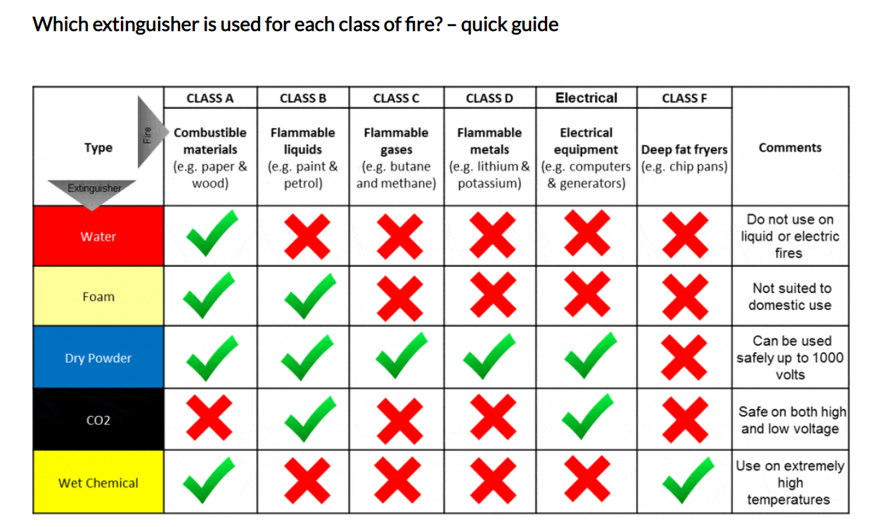
First-Aid Firefighting
Types of fire extinguisher guide - Surrey Fire & Safety
Notes:
No notes

Slide 12
Fire Safety Summary
Employers (and/or building owners or occupiers) must:
Carry out a fire safety risk assessment (RA)
Keep it up to date
Ensure adequate and appropriate fire safety measures are in place to minimise the risk of injury or loss of life in the event of a fire
Notes:
No notes

Slide 13
Note to Lecturers
For SGUK certificate Word template please contact
contact@safetygroupsuk.org.uk
Notes:
No Notes for this slide

Slide 14
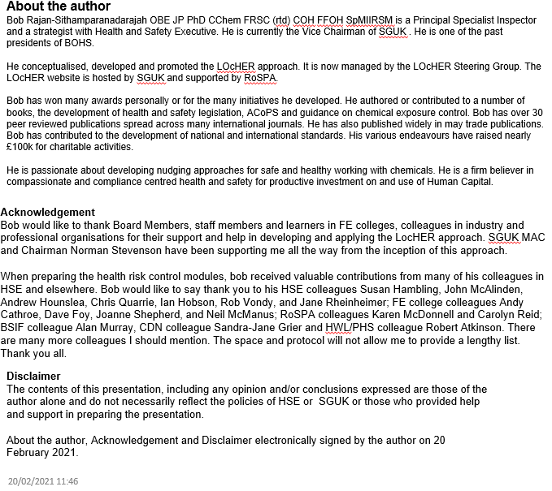
Notes:
No Notes for this slide

