Slide 1
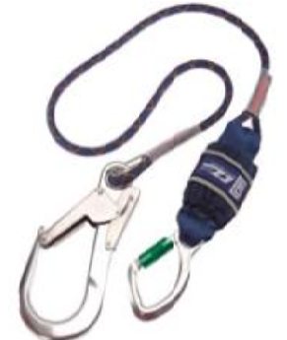
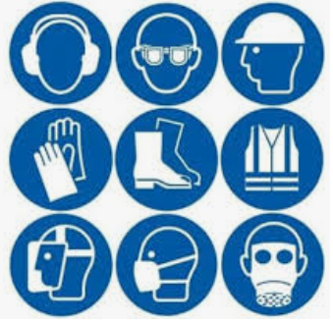
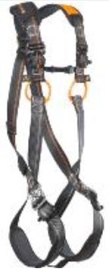
Personal Protective Equipment (PPE)
at Work
Dr. Bob Rajan OBE JP PhD
Read notes where provided
Notes:
PPE come in all shapes and designs. They can be used for protecting various parts of the body, as you will see from the figure on this slide.

Slide 2
PPE is used widely in workplaces
Before “dishing them out”
Employers have to:
Ask many searching questions and
Have answers to those questions
Justified in Risk Assessment for the Job
Notes:
There are many situations where workers have been fatally or seriously injured because wrong or inappropriate PPE was provided.
That is why many questions must be asked. The selection should be made by a competent person or after referring to a reputable guidance, like those produced by HSE.

Slide 3
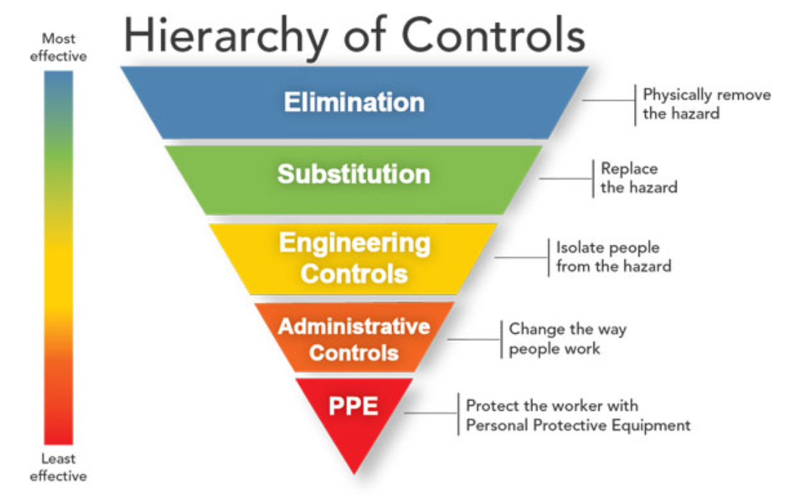
Because PPE is Least effective
Notes:
PPE when it fails, the wearer will be left without any or effective protection.
You will see few examples in a while.
An engineering control with suitable checks and balance (e.g. alarms to warn failures) will protect all people close to the hazard. Where as PPE will only protect the wearer.

Slide 4
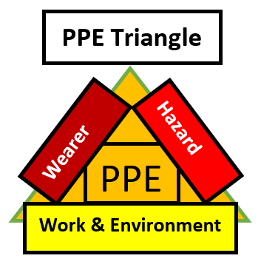
Because PPE is Least effective
It must be:
Right for all aspects of the
Used correctly
Maintained and
Stored correctly
Notes:
As you can see, for a PPE to provide adequate protection, there should be harmony on all sides of the triangle. Any failure will cause imbalance which can lead to inadequate protection to the wearer.
LOcHER Hands ON:
What could happen, if a construction worker wear’s a hard hat with cracks. Then he/she goes to work in an area where falling objects may land on the head.

Slide 5
So, what should your employer do?
Only use PPE as a last resort
Choose carefully
Provide free of charge
Maintain
Train users to:
use correctly
carry out fit checking every time it is worn
report faults
Notes:
Training to use PPE and the essential PPE identified in a risk assessment should be provided free of charge.
Same thing applies for maintaining the PPE.

Slide 6
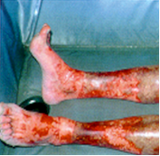
PPE Selection and Use
It is not simple in many work situations.
Make a mistake, the wearer can be:
Injured
Become ill
Fatally injured
Notes:
LOcHER Hands ON:
1. An employee had serious burns to his legs. It was caused by wet and corrosive mortar. It got inside the boots he was wearing (by looking at the photo, can you visualise where the upper part of the boots sat). The operator did not feel the effects of the wet mortar, until the situation has become very serious.
2. Can you look at the other photo and discuss the shortcomings on PPE selection – focus on eye protection and hearing protection for this discussion.
You can look at many other issues, including coverall, street clothing, and engineering controls if time permits.

Slide 7
PPE Selection and Use
Two short films, by apprentices, demonstrate the importance of:
Using appropriate control measures, and
Correct selection and use of PPE
Preston's College Plumbing group #locherproject 2017-18 Hard hats reducing injuries saving lives – YouTube
#Locherproject Preston's College Plumbing - Why wear Safety Boots?? (draft version) - YouTube
Notes:
Will you ever consider wearing a leisure trainers at work where slips/ trips is a serious potential and hard objects lay on the work area floor.

Slide 8
PPE Selection
Hazard
What is it?
Where in the workplace?
In what form?
What is the power, intensity or concentration of the hazard, when the hazardous event occurs?
How does the hazard come into contact with the PPE wearer?
Is the PPE certified for use against the hazard and the environment?
Notes:
Apply this PPE triangle requirements to a situation at your training area.

Slide 9
PPE Selection
Work & Environment
What is the work activity?
How does the hazardous event created by the activity?
Is the PPE suitable for the work activity?
Is it suitable for the work environment?
Is it compatible with any other PPE Used?
Notes:
No notes

Slide 10
PPE Selection
Wearer
Who is the wearer?
How long the PPE is to be worn?
Is more than one PPE to be worn?
Will all the PPE work together to provide adequate protection?
Is the PPE the right size for the wearer?
Notes:
No notes

Slide 11
What should a PPE wearer do?
Wear PPE correctly
Fit check before entering the hazardous area
Change reusable parts as instructed by the employer
Don’t put PPE to a side because the work takes just a few minutes
When not in use store correctly
Return for maintenance, as instructed
Don’t wear damaged PPE
Report faults straight away
Notes:
Follow these to look after your H&S.

Slide 12
PPE is the last line of protection If it fails The wearer will lose protection
Notes:
No notes

Slide 13
PPE Selection and Use
It is not simple in many work situations.
Make a mistake, wearer can be:
Injured
Become ill
Fatally injured
Seek help from competent people,
one such group is:
Notes:
No Notes

Slide 14
PPE knowledge Test – Print this slide, write down your answers and hand it to your tutor. If you are not sure of an answer, go back to the numbered slide, revise and then answer.
1. When selecting a suitable and adequate PPE what factors should be considered:
Hazard; B Work activity; C. Work environment; and D …………… (Slide 4).
2. A PPE is the most effective control solution among the hierarchy of controls
because it is worn by the wearer(Slide 3).
3. When PPE is identified and justified in risk assessments as a control option,
employers can charge their employees when providing essential PPE. (Slide 5).
4. Employees should learn to use a PPE by reading the user instruction provided (Slide 5).
5. Employees only need to just put on a PPE and expect it to work and provide
adequate protection against the intended hazard (slide 5).
True
False
True
False
True
False
True
False
Notes:
No notes

Slide 15
Note to Lecturers
For SGUK certificate Word template please contact
contact@safetygroupsuk.org.uk

Slide 16
Notes:
No Notes for this slide

