Slide 1
Don’t Lose Your Hearing It’s so Precious Introduction
Dr. Bob Rajan OBE JP PhD
Please study each slide with its accompanying notes to get to know the subject
Notes:
Noise is part of everyday life, but too much noise can cause permanent and disabling hearing damage. This can be hearing loss that gets worse over time or the damage can be caused by sudden, and extremely loud noises, for example from power presses, powered nail guns.
With hearing damage, conversation becomes difficult or impossible; your family may complain about television being too loud because you have turned it to a high volume setting; you have trouble using telephone; and you may have sleepless nights due to tinnitus – simply speaking continuous noise in the ear.
By the time you notice the problem, it is probably too late.
However, there is no need for your hearing to be damaged by your work – your employer has legal duties to protect your hearing and should put measures in place to reduce the risk.
You can play a part in helping your employer to protect you hearing.

Slide 2
About the module
Introduction
About Sound and Noise
About Noise Induced Hearing Loss (NIHL)
Recognising noise problems at work
Employers duties to protect your hearing
Your duties to protect your hearing
Examples of noise control solutions
Hearing protectors
Quiz and answers on noise at work
Notes:
This module has 6 units. It would take about 60 minutes to present or use it in self-directed study.
Any exposure limits information included is for completeness only. Learners need to know that at certain noise levels, employers have specific legal duties to protect the workers hearing.
Information in this presentation should help learners to produce “Assignments” on Health and Safety module associated with their apprenticeship studies.
Furthermore, it should help learners to look after their precious hearing.

Slide 3
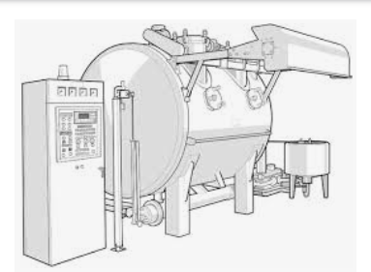
A personal story of a Fabric Dyer
He worked in a noisy dyehouse for 15 years. After a hearing check, he was found to have 50% hearing loss at the age of 37.
He now has problems using the phone, and needs an amplifier
Traffic is hard to hear unless he is right next to it, so crossing a road becomes stressful.
When driving, he often stays in 3rd gear too long as he can't hear the engine revving.
An example, dying machine
Source: https://www.hse.gov.uk/noise/worried.htm
You don’t have to suffer the same kind of fate
Notes:
This personal story, published by the Health and Safety Executive (HSE), is a reminder to all of us about the need to:
look after our hearing at work and
take precautions to minimise the risk of noise related hearing damage known as Noise Induced Hearing Loss (NIHL).
LOcHER Hands On:
What simple action could have been taken by the dyer’s employer to prevent noise induced hearing loss?
(Tutors’ Notes: please let learners explore options. Answers might be: ear plugs, ear muffs, screens, robots etc.)
A simple solution – a hearing protector.
Hearing loss to this dyer could have been prevented, if his employer provided a suitable hearing protector (and the dyer using it correctly.)

Slide 4
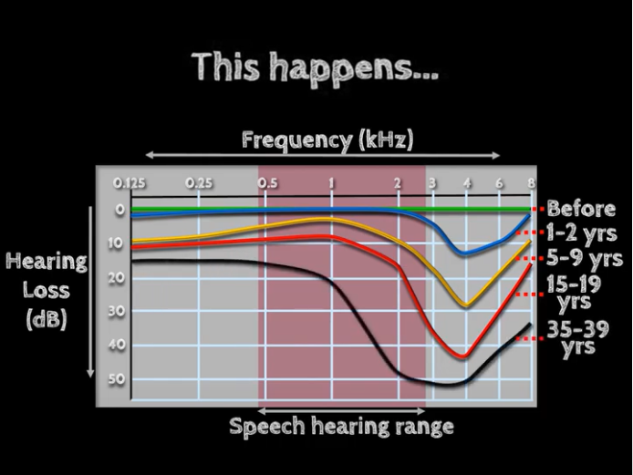
Lose Your Hearing
https://www.youtube.com/watch?v=2F1a9WPdETk
Notes:
Notes: This audio-visual demonstration is based on the information obtained following an extensive and detailed research by the University of Southampton and other researchers.
This LOcHER demonstration shows the effects of progressive Noise Induced Hearing Loss (NIHL) over a period.
At the early stages of NIHL, it might seem that things are okay. As the NIHL becomes progressive, one would loose the precious hearing, resulting in many consequences such as difficulty to hear television or traffic noise. Play the YouTube video.
In Part 2, we will look at the differences between sound and noise.

Slide 5
Don’t Lose Your Hearing It’s so Precious Sound and Noise Part 2
Notes:
Not Notes for this page

Slide 6
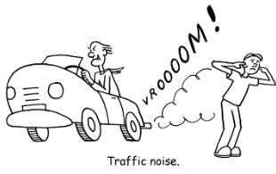
Sound and Noise
Sound is what we hear
Noise is unwanted sound
- it can be damaging to hearing
The differentiation between sound and noise depends on the listener and the circumstance
KPN
Notes:
Sound is whatever you hear. So, noise is part of everyday life.
But, noise is the unwanted sound with a big exclamation mark.
Why? – The differentiation between sound and noise depends on the LISTENER and the CIRCUMSTANCE.
You can appreciate this differentiation from the Vroooom! figure. The driver is enjoying the sound from the noisy exhaust, revving engine and the wind. For the young person standing on the roadside, the Vroooom sound is intrusive, annoying and disturbing, so it is noise for him.
How can we explore this in another way?
Just think of you as a pop music lover. You are listening to music with high bass, and lots of people singing along with the singer in the hall. Many, including you, are shouting and clapping with happiness. You are enjoying the sound and the ambiance, right!
Now, imagine that you are fast asleep and the same group of people and the music are in your bedroom. This time, the fun sound becomes an intrusive and annoying noise. It is having a serious effect on your sleep and life, right!

Slide 7
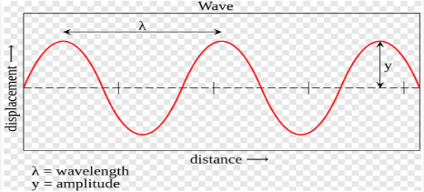
Sound
Sound energy travels in waves
It can be measured in frequency and amplitude
Frequency (λ) is number of wave cycles/unit time
E.g. measured in cycles/sec (Hz)
Amplitude (y) measures loudness of the wave
- It is measured in decibels (dB) of sound pressure
Egg.com
Notes:
We all know that sound is a form of energy like heat and light. Sound travels in waves.
Normal day-to-day sound is made of a number of frequencies and noise levels. That combination makes sound a joy and at times annoying and dangerous.
Now, we will explore the terms frequency and amplitude in practical ways.
Just imagine a calm sea with shallow waves with mellow sound hitting the shore every 30 seconds. Then, on a windy day, high peak, noisy waves hitting the shore every 10 seconds.
We can demonstrate this effect using the wave diagram on this slide.
(Notes: Set the presentation to “normal” in view mode. Just click the diagram to highlight and then pull and push with the mouse arrow.)
Leaners can see the shallow crest and long frequency when elongated. Opposite when compressed short frequencies and high amplitudes.

Slide 8
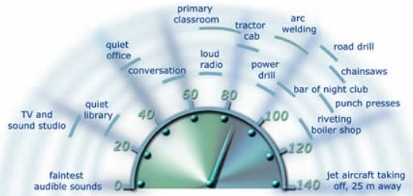
Sound Levels
Measured in unit known as decibels (dB)
Many machines associated with work activities
create noise above 80dB
HSE
Above 80dB exposure over a day,
employers have to take specific actions to protect your hearing
Notes:
Always remember, exposure to high levels of noise can cause hearing damage, if precautions are not in place.
Noise levels in a workplace is measured in a unit called decibels - Named after the Scottish Engineer Alexander Graham Bell, who invented the telephone.
In simple terms, a dB measurement can tell us the sound level at a given point in time. It is like a car milometer pointer showing the speed at a given point. The MPH tells us the average speed over a period using calculations inside the milometer.
A similar approach is used for measuring average noise exposure over a time. The “A” weighted dB measurement mimics the way ear “feels and sense” the sound AT DIFFERENT frequencies.
To put some more flesh, now, let us look at the sound level meter decibel dashboard on this slide. It shows sound levels produced during different activities/jobs.

Slide 9
How loud is too Loud? “Rules of Thumb”
1. Most hand-held power tools generate:
90 to 105 dB(A)
Test | Most Likely Noise Level (dB(A))
2. You have to shout to talk to someone 2 m away | 85 (or higher)
3. You have to shout to talk to someone 1 m away | 90 (or higher)
Notes:
To make a quick assessment of a potential noise problem at your workplace, you or your employer could, use “rules of thumb”. You only need to understand these rules. Your employer can deal with making a suitable and sufficient risk assessment or making Leq measurements of noise.
The “rules of thumb” approach is like an early assessment for a heart condition. “Have I got pain in the left arm and chest”; then moving on to pressure measurements, then to exercise tests, followed by all sorts of complicated tests and measurements.
So, for you to assess the likelihood of a noise problem in your workplace, “rules of thumb” are given in this slide.
Most of the hand-held power tools create noise that can damage your hearing.
If the situation in your workplace is like what is said on this slide, hey, it is highly likely that a noise problem exists and the likelihood of NIHL among workers is high. It is a good practice to bring it to the attention of your employer or your safety representative, so that actions can be taken to protect your hearing.
Did you know? if your employer is not listening to your concerns, you can call HSE offices and give confidential H&S information to them. HSE can consider appropriate actions to help protect your hearing.

Slide 10
Working in Noisy Areas Signs and Effects of Exposure
Situation Tests
1. Do You (people) have ringing sound in Your (their) ears at the end of the shift?
2. Do You (people) increase the car radio volume on (you) their return journey after the shift?
3. After years of exposure, do You (people) have problems understanding/maintaining conversation, listening to music or TV
Notes:
For you to check for noise and the early sigs of NIHL, here are some “situational awareness” tests to put jam on the bread- rules of thumb.
If the rules of thumb explained in the previous slide and/or this situational awareness tests are positive, do not delay.
Speak to your boss or your safety representative at your workplace. Or to the person responsible for health and safety at your workplace.
Your employer will have to get things moving fast to sort out the problem and to protect the hearing of their employees.

Slide 11
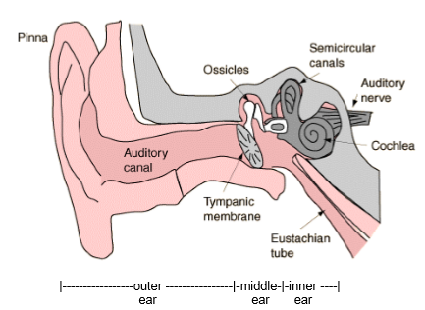
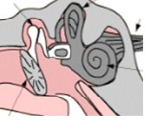
Detecting Sound and Noise
Anvil
For balancing
Hammer
Nerves bundle
“Snail”
Ear drum
Stirrup (“tuning-fork”)
Notes:
We use our ears to detect sound. Our ear is an intricate sound detection machine with many parts. It does a lot of work for us, including hearing, balance, draining fluids and wax.
The ear drum is connected to three smallest bones in our body, seen as three white patches in these figures. In simple language, these are called hammer, anvil and stirrup.
As you can see, the hammer bone looks like a hammer’s head; the anvil bone is shaped like an anvil. The name stirrup has a good reason, we will learn about it in the next slide.
So, sound waves, reaching the side of our head, get directed by our earlobe into the ear cannel. It, in turn, channels the sound waves towards the ear drum. As the name suggests, when the sound hits the drum, it will vibrate. These vibrations are picked by the three bones and passed onto the snail shell looking organ called cochlea. The sound signals reaching the cochlea are picked by the very fine nerve endings in the cochlea and are passed onto the brain through the auditory nerve.

Slide 12
Noise Induced Hearing Loss? (NIHL)
An irreversible damage to the ears caused by exposure to “high levels of noise”
NIHL is mainly due to damage to nerve endings in the Cochlea
Tiny nerve endings
CDC electron microscope picture of
a cochlea and nerve endings
Notes:
NIHL is an irreversible damage to our hearing. Once gone, it is gone for ever.
NIHL is caused by high levels of noise. For this reason, the Control of Noise at Work Regulations have noise exposure levels and associated legal duties to help minimise NIHL caused by work.
You have already learnt “rules of thumb” and “situational awareness tests” to understand what could be considered as high levels of noise.
Presenters notes: You may reinforce the “rules of thumb” and “situational awareness tests” messages by going back to slides 9 and 10.
Coming back to NIHL, the “snail shell” look alike cochlea has millions of very tiny nerve endings inside, as shown by the CDC figure on the slide. These nerve endings get stirred up by sound signals coming from the stirrup bone. These tiny nerve ending could be imagined as very, very fine hair strands. BUT, the diameter of a single nerve ending is 100s of times smaller than that of a hair strand on your body. You will need a powerful electron microscope to see nerve endings shown in the CDC figure.
These nerve ending will move about according to the sound waves reaching them. High levels of noise can damage these nerve ending and kill them for ever. A dead nerve ending will not grow again. So the affected person develops NIHL. The development of NIHL is usually gradual, as we have seen in the LOcHER demonstration film, cited in slide 4.
For discussion and reflective understanding: What happens to wheat plants in a field when high winds hit them over a period? (Some areas get flattened - in places where the wind effect was high). A similar effects can happen to the nerve endings. You will see a short clip cited in the next slide.

Slide 13
NIHL Related Damage to Nerve Endings
NIHL damage is mainly to nerve endings in the Cochlea
CDC electron microscope picture of
a cochlea and nerve endings
Pipe cleaners
Visualising the Damage
https://www.youtube.com/watch?v=krqGja-pDcc&feature=youtu.be
Notes:
Presenters notes: please obtain pipe cleaners from hobby craft shops or educational material suppliers. Cut each cleaner into 5cm long pieces.
LOcHER Hand On: We learnt that NIHL is an irreversible damage to our hearing. Once gone, it is gone for ever.
Hand out some of the 5cm length pipe cleaner strands to some of your learners.
Ask them to feel the hairs. - how tiny and how soft they are. Now, explain that the tiny nerve endings in the cochlea is 1000s of time smaller in diameter than the hairs in the pipe cleaner.
Ask the audience to pull few hairs off the cleaner. Then ask them to put it back. Just impossible. Similarly, if they work rough on them, hairs will become damaged.
So, summarise that: if the tiny nerve endings in the cochlea are damaged or killed, it is not feasible to fix them. Here is another way of visualising.
Play the YouTube film: (This 30 seconds film was produced by the Centre for Disease Control (CDC) in the USA .
So the overall lesson is - look after your hearing whether at work or in your social life. It is so precious.

Slide 14
Likely After Effects of NIHL
Once hearing has gone it won’t come back
Ringing, buzzing, whistling… in ears (Tinnitus)
https://m.youtube.com/watch?v=83laYgUtbv8
Sleep disturbance
Difficulty to maintain conversation
Other effects
e.g. cannot hear safety warning sounds
Notes:
There are many after effects of NIHL. This slide lists a number of examples.
LOcHER Hands On:
Tinnitus is one of the debilitating problems caused by NIHL. You will appreciate this troublesome problem by listening to the short demonstration from a YouTube clip. Play the clip.
Notes to the Presenter: please keep the volume down.

Slide 15
Is there a noise problem where You work?
Tell-tale signs:
Intrusive/annoying noise
Have to raise your voice to have a normal conversation when about 2 m apart
Noisy powered tools or machinery in use
The work is known to have noisy tasks
Impact noise is created
Notes:
So as a reminder, this slide provides a summary of “Rules of Thumb” to detect the potential for noise problems at your work.
1. Intrusive noise – like a busy street, a full-on vacuum cleaner or a crowded restaurant. Just imagine if you have to be working in such an environment all day.
2. Do you have to raise your voice to have a normal conversation when about 2 m apart for at least part of the day.
3. If your work is known to have noisy tasks - in sectors like construction, demolition, road repair; woodworking; plastics processing; engineering; textile manufacture; general fabrication; forging or stamping; paper or board making; canning or bottling; foundries; waste and recycling.
In other words, look out for noise problems using the Rules of Thumb.
Notes to the presenter: impact noise is not always a problem in every workplace, so use the information appropriate to your learners’ line of study.
Impact noise: Does your work or work activity close-by involves activities such as hammering, mechanical stapling, nail guns use, drop forging, pneumatic impact tools etc or explosive sources such as cartridge-operated tools or detonators, or guns.

Slide 16
Don’t Lose Your Hearing It’s so Precious Noise and Law Part 3
Notes:
Recap:
Noise is part of everyday life, but too much noise can cause permanent and disabling hearing damage.
This can be hearing loss that gets worse over time, damage caused by sudden, extremely loud noises, or tinnitus (permanent ringing in the ears).
With hearing damage, conversation becomes difficult or impossible.
Your family complains about the television being too loud, you have trouble using the telephone, and you may be unable to sleep. By the time you notice, it is probably too late.
However, there is no need for your hearing to be damaged by your work – your employer has a duty to protect you and should be working on measures to reduce the risk. You can play a part in helping your employer to protect you.

Slide 17
Who has Responsibilities for Preventing Work-Related NIHL?
Control of Noise at
Work Regulation 2005
Employers
Sub-contractors
Self-employed
Designers
Manufacturers
Suppliers
Employees
Notes:
Now then, if there is a noise problem at your workplace, the employer is the key person to sort things out. However many others have responsibility under Noise at Work Regulations and the Health and Safety at Work (HSW) Act.
Once again, you see why we called (in the health and safety and law modules) the HSW Act as an umbrella act. Its powers permeates into all work related activities.
LOcHER Hands On:
Why whole load of people are listed, other than the employer.
For example, a sub-contractor’s work activities can affect the health and safety of the workers at the premises.
Manufacturers have to take actions so that their equipment, machinery etc that they make/produce/supply are safe to use at work. They have legal duties to provide information on what types exposure control measures are needed when their equipment etc is used at work.
Discuss/think about others in the list.

Slide 18
Basic Requirements of the Law
Employers have specified legal duties based on noise levels
(For information only)
Your employer MUST take specific actions when:
Daily average exposure is 80 dB Lep,d
When daily average exposure is 85 dB Lep,d
Exposure limit value (87 dB Lep,d) is reached
Peak/Impact noise is 135 dB and 137 dB
Notes:
All these details are for the competent person, who is helping the employer.
For you, “Rules of Thumb” and “Situational Awareness Tests” are useful.
You need to know that exposure actions values exist to place specific duties on employers.
Again, for your practical purposes, you can relate these values using Rules of thumb and Situational Awareness Tests. You can use these to have conversations with your employer.

Slide 19
Employers Legal Duties A practical framework
Assess the risks from noise exposure
Take action to reduce risks from noise exposure
Provide hearing protection, where required
Make sure legal limits on noise are not exceeded
Provide information, instruction and training
Get workers/their representatives involved
Carry out health surveillance for those at risk of hearing damage
Notes:
No notes

Slide 20
Employers Legal Duties in simple terms
Your employer should be looking at:
Using quieter equipment
Using a different and quieter process
Applying engineering/technical noise control solutions
Laying out of the workplace to create quiet workstations
Improved ways of working to reduce noise levels
Limiting the time you spend in noisy areas
Marking mandatory hearing protection zones
Notes:
No Notes

Slide 21
Don’t Lose Your Hearing It’s so Precious Noise Control - Problems and Solutions Part 4
Notes:
No Notes

Slide 22
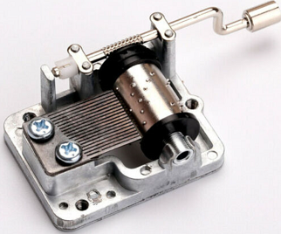
Learning: Noise Control Solutions
LOcHER Hands On - 1
Mechanical hand-cranked
music generator
Pan cleaner
Notes:
We have already learnt that sound travels in waves. The differentiations between sound and noise depends on the listener and the situation.
We also learnt (i) about Rules of Thumb and Situational Awareness Tests for judging whether a noise problem exists at a workplace. (ii) that employers have legal duties to prevent workers exposure to noise.
In order to appreciate the way in which noise exposure could be reduced by engineering methods, we are going to do a few LOcHER experiments.
(Tutor’s notes: you can buy musical generators from educational materials suppliers. Pan cleaner from a supermarket.
If you can use a noise app to measure noise levels, it will be good for increased engagement and impression.) Let learners play with the machine on their desks. Then let them place the pan cleaner on the desk and place the machine on the pan cleaner. Then play the machine. They will very quickly learn about noise insulation.
(when the machine is played, while it is seated directly on the desk, the solid surface amplifies and conducts the music created by the machine. When the pan cleaner (with lots air spaces and irregular weave) is used as insulation, the music waves created by the machine gets deenergised by the weave and the air spaces, before the waves reach the table. So, a significant reduction in noise levels. Simple, practical and engaging way to demonstrate noise insulation.

Slide 23
Learning: Noise Control Solutions
LOcHER Hands On - 2
Felt pads
Notes:
Tutor’s Notes: If you can use a noise app to measure noise levels, it will be good for increased engagement, understanding and impression.
This is a simple way for understanding how noise including impact noise could be reduced.
Here we have a pen and three pieces of felt pads that we use at home to stop furniture moving about or to reduce indentation on carpets and wooden floors.
Using the pen, create an impact noise on a desk or table at two seconds interval. Stop. Now place a felt pad on the table and create impact noise on the felt pad. Learners can hear and understand the significant noise reduction caused by the felt pad. A simple but easy to use demonstration.
(LOcHER is about using simple, safe and easy to demonstrate approaches to engage learners and to leave a lasting impression so that they can look after their health at work.)

Slide 24
Learning: Noise Control Solutions
LOcHER Hands On - 3
Notes:
Tutor’s Notes: please have a number of balloons and a same number of bath sponge or similar.
If you can use a noise app to measure noise levels, it will be good for increased engagement, understanding and impression.
In this experiment, learners will be introduced to sound insulation when using compressed air.
Here learners will inflate a balloon, then let the air out while the balloon neck is widely open (while holding the balloon carefully, otherwise it will fly off). This action will let the air escape. The noise created will be much less because air is escaping through a fully open neck.
In the next round, blow the balloon and keep the neck open as a fine slit opening while the air is escaping. This time the level of noise will be much greater than the previous occasion.
In the third round, blow the balloon, and repeat the action as in second round while the air escapes through the sponge. It means that much of the noise energy is absorbed by the sponge material and the air spaces in it.
We will now see this approach in real life applications.

Slide 25
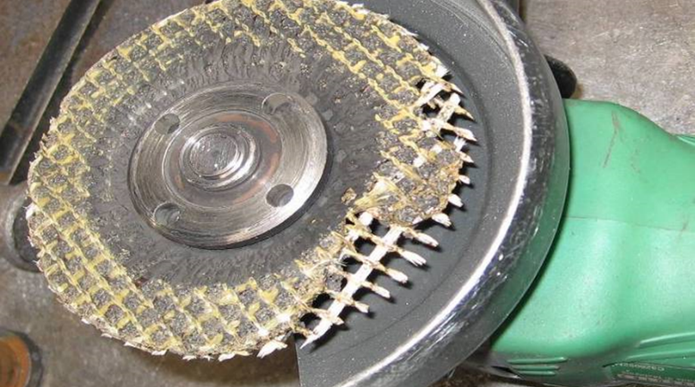
Learning: Noise Control Solutions
Noise Source | Unmaintained tools
Typical workplace uses | Grinding, cutting, sawing etc (Grinders, cutting sawing tools etc)
Solutions | Regular checks, tests and maintenance
Outcomes | Improved productivity, reduced wear and tear and significant noise reduction
Notes:
This slide is for you to get a quick understanding that noise at work can be managed using simple practical approaches.
Would you consider this grinder as a ready-to-use and in effective condition for you to use.

Slide 26
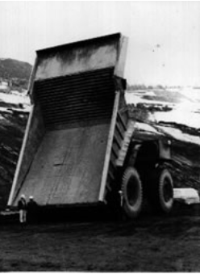
Learning: Noise Control Solutions
Noise Source | Dumper truck loading bay
Typical workplaces & uses | Quarries, construction sites, traders, garden centres etc; Noise caused by stones loaded onto uninsulated metal loading bays of lorries
Solutions | Reduce noise levels by lining with abrasion-resistant heavy dusty
Outcomes | The lining reduced noise levels by 14 dB. The treatment also significantly increased truck body life.
Notes:
This slide is for you to get a quick understanding that noise at work can be managed using simple practical approaches.

Slide 27
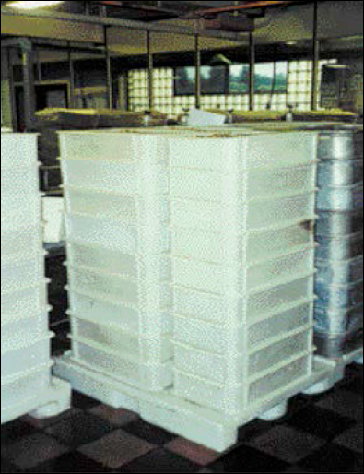
Learning: Noise Control Solutions
Noise Source | Products received in metal trays
Typical workplace uses | For receiving and collecting sweets, nuts, marbles, machined items etc.
Solutions | Noise damping - using high density plastic trays instead of metal trays
Outcomes | 4 to 5 dB reduction in noise
Notes:
This slide is for you to get a quick understanding that noise at work can be managed using simple practical approaches.

Slide 28
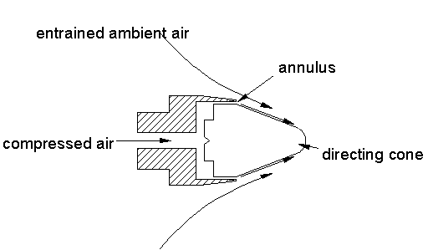
Learning: Noise Control Solutions
Noise Source | Compressed air nozzles
Typical workplace uses | Cooling, cleaning, drying, demisting, blowing
Solution | Replaced open pipe nozzles (A and B) with quiet, units,(C)
Outcomes | Reduced noise levels up to 10dB; Less noise intrusive work area; Use less compressed air; Reduced costs
A
B
C
Notes:
This slide is for you to get a quick understanding that noise at work can be managed using simple practical approaches.

Slide 29
Don’t Lose Your Hearing It’s so Precious Hearing Protectors Part 5

Slide 30
Selection and Use of Hearing Protectors
Roles of hearing protection:
As a temporary measure while noise control is being implemented
To reduce residual noise exposure risk that is present after implementing noise control measures
where noise exposure is as low as reasonably practicable but still above the upper exposure action value
Notes:
This slide describes where hearing protectors may be used.
As a temporary measure while noise control is being implemented. It means that employer is in the process of implementing other control measures and hearing protector is used in the mean time.
To reduce residual noise exposure risk that is present after implementing noise control measures. In some industries, engineering control measures will not on their own will be enough to minimise the risk of NIHL. In these circumstances. Hearing protector will be needed. For example, in many food production line.
where noise exposure is as low as reasonably practicable but still above the upper exposure action value. For example, when using a modern “Jack-Hammer” with time limitation on use.

Slide 31
Incorrect Use of Hearing protectors
HSE Research shows:
Thousands of workers who are using hearing protection are NOT receiving adequate protection
The effectiveness of earmuffs is reduced by:
Long hair mass in seal area
Side arms of eye protectors in seal area
Long and thick sideburns in seal area
Damaged earmuff seal and padding
Slackened tension on muff holders
(HSE Research Report RR720, “Real world use and
performance of hearing protection”, 2009)
Notes:
Although lots of people use hearing protectors at work, a large number of people are not benefiting from the use of hearing protectors.
The reasons for this is mainly due to incorrect use.
Examples are listed in this slide.

Slide 32
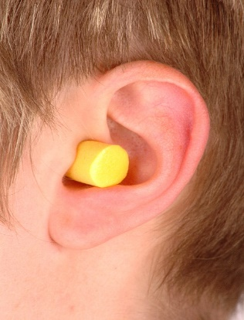
Incorrect Use of Hearing Protectors
C
A
B
What are the incorrect use issues here?
See more examples in HSE research Report 720
Notes:
LOcHER Hands On:
What are the issues here in terms of incorrect use of hearing protectors.
What are your thoughts? Then look at the answers below.
A. Ear plug not inserted correctly. It should be rolled tightly and fully inserted in the ear cannel
B. Earmuffs holder is not in the correct place and the muffs are worn over the hood. It means that the muffs ware not going to provide a tight seal. Noise will leak past the seals.
C. Earmuffs are worn over clothing and the RPE straps are in the way of earmuff seal.

Slide 33
Don’t Lose Your Hearing It’s so Precious Summary
Find out - is there a noise problem at your workplace?
Work with your employer:
- To control noise at source
- Buy quiet machinery and power tools
- Select suitable and adequate hearing protectors
Use machinery/tools correctly
Check and maintain machinery/tools regularly
Use Hearing protectors correctly, including in areas marked
Notes:
This slide summarises helpful points to help you look after your hearing at work

Slide 34
Preventing Noise Induced Healing Loss
Questions
For the questions in the next few slides, select either
TRUE or FALSE answer.
Please remember, if a question is answered incorrectly, you will be taken to the slide where correct answer is explained. After reading the correct answer, return to the question and tick the correct answer and move on to the next question.
Notes:
No notes

Slide 35
Q1 – Noise at work
1. At your work area, you need to shout to talk to a workmate, who is 2 metres away from you. It is an indicator that there is a noise exposure problem.
True
False

Slide 36
Q2 – Noise at work
At your work area, you need to shout to talk to a workmate, who is 2 metres away from you. It is an indicator that there is a noise exposure problem.
You regularly increase car radio volume on your return journey after work. Can it be a sign of exposure to excessive noise at work?
True
False
Notes:
No notes

Slide 37
Q3 – Noise at work
At your work area, you need to shout to talk to a workmate, who is 2 metres away from you. It is an indicator that there is a noise exposure problem.
You regularly increase car radio volume on your return journey after work. Can it be a sign of exposure to excessive noise at work?
Exposure to high levels of noise at work can damage or destroy tiny nerve ending in your ears.
True
False
Notes:
No notes

Slide 38
Q4 – Noise at work
At your work area, you need to shout to talk to a workmate, who is 2 metres away from you. It is an indicator that there is a noise exposure problem.
You regularly increase car radio volume on your return journey after work. Can it be a sign of exposure to excessive noise at work?
Exposure to high levels of noise can damage or destroy tiny nerve ending in your ears.
Noise induced hearing loss, resulting from damage to nerve endings in ears, is not permanent.
True
False
Notes:
No notes

Slide 39
Q5 – Noise at work
At your work area, you need to shout to talk to a workmate, who is 2 metres away from you. It is an indicator that there is a noise exposure problem.
You regularly increase car radio volume on your return journey after work. Can it be a sign of exposure to excessive noise at work?
Exposure to high levels of noise can damage or destroy tiny nerve ending in your ears.
Noise induced hearing loss (NIHL), resulting from damage to nerve endings in ears, is not permanent.
Regular exposure to noise from high impact nail guns can be a source for NIHL.
True
False
Notes:
No notes

Slide 40
Q6 – Noise at work
At your work area, you need to shout to talk to a workmate, who is 2 metres away from you. It is an indicator that there is a noise exposure problem.
You regularly increase car radio volume on your return journey after work. Can it be a sign of exposure to excessive noise at work?
Exposure to high levels of noise can damage or destroy tiny nerve ending in your ears.
Noise induced hearing loss (NIHL), resulting from damage to nerve endings in ears, is not permanent.
Regular exposure to noise from high impact nail guns can be a source for NIHL.
A self-employed subcontractor is doing high level noise (85 to 90dB) creating work activities in an area of the factory (not owned by her) where other workers are present. As a self-employed and as a subcontractor, she does not have to implement noise control measures or cooperate with the factory employer.
True
False
Notes:
No notes

Slide 41
Q7 – Noise at work
At your work area, you need to shout to talk to a workmate, who is 2 metres away from you. It is an indicator that there is a noise exposure problem.
You regularly increase car radio volume on your return journey after work. Can it be a sign of exposure to excessive noise at work?
Exposure to high levels of noise can damage or destroy tiny nerve ending in your ears.
Noise induced hearing loss (NIHL), resulting from damage to nerve endings in ears, is not permanent.
Regular exposure to noise from high impact nail guns can be a source for NIHL.
A self-employed subcontractor is doing high level noise (85 to 90dB) creating work activities in an area of the factory (not owned by her) where other workers are present. As a self-employed and as a subcontractor, she does not have to comply with the Control of Noise at Work Regulations.
Employers, undertaking noisy activities that could cause NIHL to their workers, have no specified actions under law to protect the hearing of their employees working just 2-days a week.
True
False
Notes:
No notes

Slide 42
Q8 – Noise at work
At your work area, you need to shout to talk to a workmate, who is 2 metres away from you. It is an indicator that there is a noise exposure problem.
You regularly increase car radio volume on your return journey after work. Can it be a sign of exposure to excessive noise at work?
Exposure to high levels of noise can damage or destroy tiny nerve ending in your ears.
Noise induced hearing loss (NIHL), resulting from damage to nerve endings in ears, is not permanent.
Regular exposure to noise from high impact nail guns can be a source for NIHL.
A self-employed subcontractor is doing high level noise (85 to 90dB) creating work activities in an area of the factory (not owned by her) where other workers are present. As a self-employed and as a subcontractor, she does not have to comply with the Control of Noise at Work Regulations.
Employers, undertaking noisy activities that could cause NIHL to their workers, have no specified actions under law to protect the hearing of their employees working just 2-days a week.
This sign means that in designated areas, it is obligatory to correctly wear suitable and adequate hearing protectors – earmuffs or ear plugs.
True
False
Notes:
No notes

Slide 43
Q9 – Noise at work
At your work area, you need to shout to talk to a workmate, who is 2 metres away from you. It is an indicator that there is a noise exposure problem.
You regularly increase car radio volume on your return journey after work. Can it be a sign of exposure to excessive noise at work?
Exposure to high levels of noise can damage or destroy tiny nerve ending in your ears.
Noise induced hearing loss (NIHL), resulting from damage to nerve endings in ears, is not permanent.
Regular exposure to noise from high impact nail guns can be a source for NIHL.
A self-employed subcontractor is doing high level noise (85 to 90dB) creating work activities in an area of the factory (not owned by her) where other workers are present. As a self-employed and as a subcontractor, she does not have to comply with the Control of Noise at Work Regulations.
Employers, undertaking noisy activities that could cause NIHL to their workers, have no specified actions under law to protect the hearing of their employees working just 2-days a week.
This sign means that in designated areas, it is obligatory to correctly wear suitable and adequate hearing protectors – earmuffs or ear plugs.
Employees have to wear hearing protectors correctly and as shown and instructed by their employers.
True
False
Notes:
No notes

Slide 44
Q10 – Noise at work
At your work area, you need to shout to talk to a workmate, who is 2 metres away from you. It is an indicator that there is a noise exposure problem.
You regularly increase car radio volume on your return journey after work. Can it be a sign of exposure to excessive noise at work?
Exposure to high levels of noise can damage or destroy tiny nerve ending in your ears.
Noise induced hearing loss (NIHL), resulting from damage to nerve endings in ears, is not permanent.
Regular exposure to noise from high impact nail guns can be a source for NIHL.
A self-employed subcontractor is doing high level noise (85 to 90dB) creating work activities in an area of the factory (not owned by her) where other workers are present. As a self-employed and as a subcontractor, she does not have to comply with the Control of Noise at Work Regulations.
Employers, undertaking noisy activities that could cause NIHL to their workers, have no specified actions under law to protect the hearing of their employees working just 2-days a week.
This sign means that in designated areas, it is obligatory to correctly wear suitable and adequate hearing protectors – earmuffs or ear plugs.
Employees have to wear hearing protectors correctly and as shown and instructed by their employers.
Inserting earplugs just at the entrance of the ear canal and not fully-in is okay to get adequate protection.
True
False
Notes:
No notes

Slide 45
How loud is too Loud? “Rules of Thumb”
1. Most hand-held power tools generate:
90 to 105 dB(A)
Test | Most Likely Noise Level (dB(A))
2. You have to shout to talk to someone 2 m away | 85 (or higher)
3. You have to shout to talk to someone 1 m away | 90 (or higher)
Back to Question
Notes:
To make a quick assessment of a potential noise problem at your workplace, you or your employer could, use “rules of thumb”. You only need to understand these, you employer can deal with making a suitable and sufficient risk assessment or making Lep measurements of noise.
The “rules of thumb” approach is like an early assessment for a heart condition. “Have I got pain in the left arm and chest”; then moving on to pressure measurements, then to exercise tests, followed by all sorts of complicated tests and measurements.
So for you to assess the likelihood of a noise problem in your workplace, “rules of thumb” are given in this slide.
Most of the hand-held power tools create noise that can damage your hearing.
If the situation in your workplace is like what is said on this slide, hey, it is highly likely that a noise problem exists and the likelihood of NIHL among workers is high. It is a good practice to bring it to the attention of your employer or your safety representative, so that actions can be taken to protect your hearing.
Did you know? if your employer is not listening to your concerns, you can call HSE offices and give confidential H&S information to them. HSE can consider appropriate actions to help protect your hearing.

Slide 46
Working in Noisy Areas Signs and Effects of Exposure
Situation Tests
1. Do You (people) have ringing sound in Your (their) ears at the end of the shift?
2. Do You (people) increase the car radio volume on their return journey after the shift?
3. After years of exposure, do You (people) have problems understanding/maintaining conversation, listening to music or TV
Back to Question
Notes:
For you to check for noise and the early sigs of NIHL, here are some “situational awareness” tests to put “jam on the butter”- rules of thumb.
If the rules of thumb explained in the previous slide and/or this situational awareness tests are positive, do not delay.
Speak to your boss or your safety representative at your workplace. Or the person responsible for health and safety at your workplace.
Your employer will have to get things moving fast to sort out the problem and to protect the hearing of their employees.

Slide 47
Noise Induced Hearing Loss? (NIHL)
An irreversible damage to the ears caused by exposure to “high levels of noise”
NIHL is mainly due to damage to nerve endings in the Cochlea
Tiny nerve endings
CDC electron microscope picture of
a cochlea and nerve endings
Back to Question
Notes:
NIHL is an irreversible damage to our hearing. Once gone, it is gone for ever.
NIHL is caused by high levels of noise. For this reason, the Control of Noise at Work Regulations have noise exposure levels and associated legal duties to help minimise NIHL caused by work. Remember that term Lep,d, the noise MPH equivalent.
You have already learnt “rules of thumb” and “situational awareness tests” to understand what could be considered as high levels of noise.
Presenters notes: You may reinforce the “rules of thumb” and “situational awareness tests” messages by going back to slides 9 and 10.
Coming back to NIHL, the “snail shell” look alike cochlea has millions of very tiny nerve endings inside, as shown by the CDC figure on the slide. These nerve endings get stirred up by sound signals coming from the stirrup bone. These tiny nerve ending could be imagined as very, very fine hair strands. BUT, the diameter of a single nerve ending is 100s of times smaller than that of a hair strand on your body. You will need a powerful electron microscope to see nerve endings shown in the CDC figure.
These nerve ending will move about according to the sound waves reaching them. High levels of noise can damage these nerve ending and kill them for ever. A dead nerve ending will not grow again. So the affected person develops NIHL. The development of NIHL is usually gradual, as we have seen in the LOcHER demonstration film, cited in slide 4.
For discussion and reflective understanding: What happens to wheat plants in a field when high winds hit them over a period? (Some areas get flattened - in places where the wind effect was high). A similar effects can happen to the nerve endings, you will see a short clip cited in the next slide)

Slide 48
NIHL Related Damage to Nerve Endings
NIHL damage is mainly to nerve endings in the Cochlea
CDC electron microscope picture of a cochlea and nerve endings
Pipe cleaners
Visualising the Damage
https://www.youtube.com/watch?v=krqGja-pDcc&feature=youtu.be
Back to Question
Notes:
Presenters notes: please obtain pipe cleaners from hobby craft shops or educational material suppliers. Cut each cleaner into 5cm long pieces.
LOcHER Hand On: We learnt that NIHL is an irreversible damage to our hearing. Once gone, it is gone for ever.
Hand out some of the 5cm length pipe cleaner strands to some of your learners.
Ask them to feel the hairs. - how tiny and how soft they are. Now, explain that the tiny nerve endings in the cochlea is 1000s of time smaller in diameter than the hairs in the pipe cleaner.
Ask the audience to pull few hairs off the cleaner. Then ask them to put it back. Just impossible. Similarly, if they work rough on them, hairs will become damaged.
So, summarise that: if the tiny nerve endings in the cochlea are damaged or killed, it is not feasible to fix them. Here is another way of visualising.
Play the YouTube film: (This 30 seconds film was produced by the Centre for Disease Control (CDC) in the USA .
So the overall lesson is - look after your hearing whether at work or in your social life. It is so precious.

Slide 49
Is there a noise problem where You work?
Tell-tale signs:
Intrusive/annoying noise
Have to raise your voice to have a normal conversation when about 2 m apart
Noisy powered tools or machinery in use
The work is known to have noisy tasks
Impact noise is created
Back to Question
Notes:
So as a reminder, this slide provides a summary of “Rules of Thumb” to detect the potential for noise problems at your work.
1. Intrusive noise – like a busy street, a full-on vacuum cleaner or a crowded restaurant. Just imagine if you have to be working in such an environment all day.
2. Do you have to raise your voice to have a normal conversation when about 2 m apart for at least part of the day.
3. If your work is known to have noisy tasks - in sectors like construction, demolition, road repair; woodworking; plastics processing; engineering; textile manufacture; general fabrication; forging or stamping; paper or board making; canning or bottling; foundries; waste and recycling.
In other words, look out for noise problems using the Rules of Thumb.
Notes to the presenter: impact noise is not always a problem in every workplace, so use the information appropriate to your learners’ line of study.
Impact noise: Does your work or work activity close-by involves activities such as hammering, mechanical stapling, nail guns use, drop forging, pneumatic impact tools etc or explosive sources such as cartridge-operated tools or detonators, or guns.

Slide 50
Who has Responsibilities for Preventing Work-Related NIHL?
Control of Noise at Work Regulation 2005
Employers
Sub-contractors
Self-employed
Designers
Manufacturers
Suppliers
Employees
Back to Question
Notes:
Now then, if there is a noise problem at your workplace, the employer is the key person to sort things out. However many others have responsibility under Noise at Work Regulations and the Health and Safety at Work (HSW) Act.
Once again, you see why we called (in the health and safety and law modules) the HSW Act as an umbrella act. Its powers permeates into all work related activities.
LOcHER Hands On:
Why whole load of people are listed, other than the employer.
For example, a sub-contractor’s work activities can affect the health and safety of the workers at the premises.
Manufacturers have to take actions so that their equipment, machinery etc that they make/produce/supply are safe to use at work. They have legal duties to provide information on what types exposure control measures are needed when their equipment etc is used at work.
Discuss others in the list.

Slide 51
Basic Requirements of the Law
Employers have specified legal duties based on noise levels
Your employer MUST take specific actions when: (For information only)
Daily average exposure is 80 dB Lep,d
When daily average exposure is 85 dB Lep,d
Exposure limit value (87 dB Lep,d) is reached
Peak/Impact noise is 135 dB and 137 dB
Back to Question
Notes:
Your average exposure level (Lep,d) measurement for the working day is one of the most widely used measures of noise exposure assessment. It depends not only on the sound level but also on the duration of the noise exposure. It is the measure of noise exposure used in the ‘Control of Noise at Work Regulations 2005’ that is currently in force in the UK.
It is intended to be used to measure the daily exposure of a worker, and it is therefore dependent on shift duration.
All these details are for the competent person, who is helping the employer.
For you, “Rules of Thumb” and “Situational Awareness Tests” are useful. You need to know that exposure actions values exist to place specific duties on employers. Again, for your practical purposes, you can relate these values using Rules of thumb and Situational Awareness Tests. You can use these to have conversations with your employer.

Slide 52
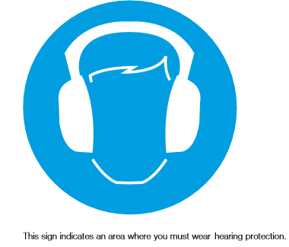
Employers Legal Duties in simple terms
Your employer should be looking at:
Using quieter equipment
Using a different and quieter process
Applying engineering/technical noise control solutions
Laying out of the workplace to create quiet workstations
Improved ways of working to reduce noise levels
Limiting the time you spend in noisy areas
Marking hearing protection zones
A mandatory blue sign
Back to Question
Notes:
In Units 4 and 5, we will look at examples to gain a more in-depth information about these requirements.

Slide 53
Selection and Use of Hearing Protectors
The role of hearing protection is:
As a temporary measure while noise control is being implemented.
To reduce residual noise exposure risk that is present after implementing noise control measures
where noise exposure is as low as reasonably practicable but still above the upper exposure action value.
A mandatory blue sign
Back to Question
Notes:
This slide describes where hearing protectors may be used.
As a temporary measure while noise control is being implemented. It means that employer is in the process of implementing other control measures and hearing protector is used in the mean time.
To reduce residual noise exposure risk that is present after implementing noise control measures. In some industries, engining control measures will not on their own will be enough to to minimise the risk of NIHL. In these circumstances. Hearing protector will be needed. For example, in many food production line.
where noise exposure is as low as reasonably practicable but still above the upper exposure action value. For example, when using a modern “Jack-Hammer” with time limitation on use.

Slide 54
Incorrect Use of Hearing Protectors
C
A
B
What are the incorrect use issues here?
See more examples in HSE research Report 720
Back to Question
Notes:
No notes

Slide 55
Note to Lecturers
For SGUK certificate Word template please contact
contact@safetygroupsuk.org.uk
Notes:
Assignment Activities (optional) (learning outcomes – How to identify hazards, control measures and put them in place before work starts)
(i) (team work or individual assignment):
Explain the key features of the COSHH regulations and apply them in selected areas of their work activities (for safe working with a hazardous substance.)
(they will explain the six essentials steps and the facts associated with them and apply them in their selected work activity example. To help them, they can draw information in INDG 136 (see next slide) and the relevant HSE’s COSHH ESSENTIAL DIRECT ADVICE SHEETS to prepare an all round and an excellent assignment and provide a list of references, safety labels on containers and safety data sheets relevant to the substance being looked at.)
Describe the methods used for identifying the hazardous properties of a manufactured product containing hazardous substances (for example concentrated metal working fluid.)
(product labels, safety data sheets, Hazards warning signs and HSE’s COSHH ESEENTIALS DIRECT ADVICE SHEETS.)
If a worker has suffered work-related asthma due to exposure to a hazardous substance at work, is this reportable to the Health and Safety Executive (HSE) under the RIDDOR regulations? If yes, who should report this and how will it be reported?
(Yes, employer or their appointed person; online to a central point using a prescribed on-line form. More information can be seen in HSE website - https://www.hse.gov.uk/riddor/report.htm)

Slide 56
Notes:
No Notes for this slide

