Slide 1
Don’t become a Victim of Hand-Arm Vibration (HAV) Related Diseases Caused by Work
Dr Bob Rajan OBE JP PhD
Vicechair
SGUK
Please study each slide with its accompanying notes to get to know the subject
Notes:
When using handheld powered work equipment or workpieces which vibrate while being processed by powered machinery, such as pedestal grinders, you can be exposed to hand arm vibration (HAV).
Exposure to HAV affects the nerves, blood vessels, muscles and joints of the hand, wrist and arm; can become severely disabling, if ignored.
It is your employer’s responsibility to protect you against exposure to vibration that can cause injury. You should help by using the control measures.

Slide 2
About the Module
What is hand-arm vibration (HAV)
Am I at risk of exposure to HAV?
What should be done to reduce risks?
Quiz and answers
Notes:
This e-module would take about 45 minutes (to present or) use it for self-directed study.
Exposure limits information is included for completeness. Learners need to know that at specified vibration exposure levels, employers have specific legal duties to protect the workers.
The information in this presentation should help learners to produce “Assignments” on Health and Safety module associated with their apprenticeship studies.
Furthermore, it should help learners to look after their health at work.

Slide 3
What is Hand-Arm Vibration?
Hand-Arm vibration (HAV) comes from the use of hand-held, hand-guided and hand-fed power tools
Vibration is transmitted to the hands, wrists and arms
It can cause painful and disabling disorders of fingers, wrists, arms, blood vessels, nerves and joints
Notes:
Note: Apart from hand-held powered tools, hand-guided tools such as lawn mowers can create high vibration levels and cause high exposures.
Similarly, hand-fed tools such as metal-processing bench mounted tools (grinders, and bevellers) can also expose a worker to vibration when feeding or holding a workpiece.
Do not ignore vibration exposure from any type of powered tools.
Many people at work are exposed to levels of hand-arm vibration which put their health at risk.
In order to protect workers health, the Control of Vibration at Work Regulations require employers to prevent or reduce the risk to their employees.
Exposure to vibrations created at work can cause vibration-related diseases. We will have a look at them in a while.

Slide 4
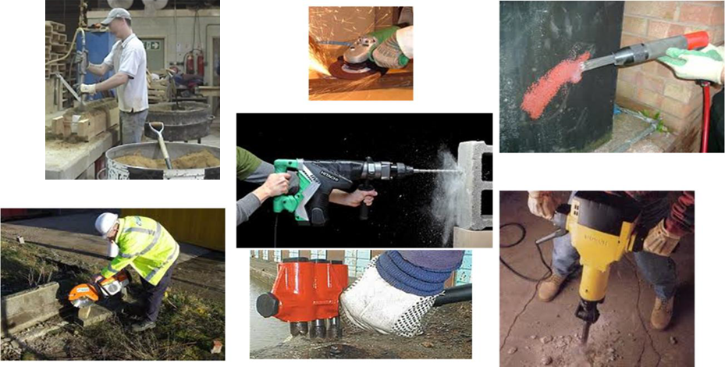
Sources of Exposure to HAV Examples
C
B
A
E
G
D
F
Notes:
Many hand-hand held power tools generate significant amount of vibration during use. Examples are provided in this slides.
Mould shakers (A), grinding tool (B), needle gun ©, cutting tool (D), drill (E), concrete breaker (F) and a jack hammer (G).
In these pictures, you will see workers wearing gloves. These gloves can help improve grip and keep hands warm.
There are no effective VIBRATION PROTECTION GLOVES. This is the findings of the Health and Safety Executive (HSE).

Slide 5
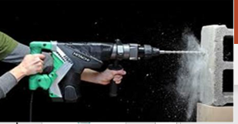
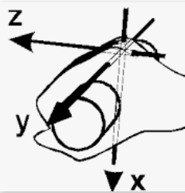
Sources of Exposure to HAV Power Drill
Notes:
LOcHER Hands-On:
Have a look at the hand-held power drill on the middle of the slide. Can you tell in which directions vibration will travel out from the drill bit.
Use the X,Y, and Z directions shown on the gripped hand to help you decide. In all three directions – towards and out of the hands (z), side to side (Y) and up and down (X).
Z-axis is the most.
In practice, the jerky movements and vibrations can travel in all directions, not just exactly on x, y and Z directions.
(ii) Have you seen a drill like the one here or a Jack-hammer in use. They create noise too.
What do you think about the use of the machine and vibration related exposure to a construction worker? – Just discuss your thought around noise and vibration.

Slide 6
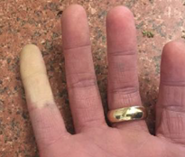
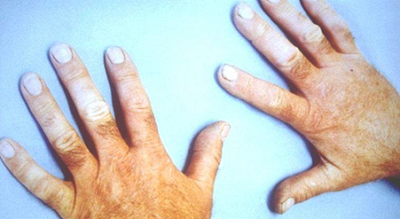
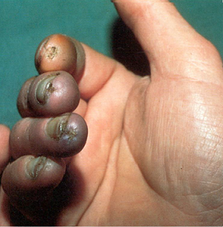
Pictorial Illustrations Examples of HAV related problems
A
B
C
Notes:
The picture marked C shows a very advanced stages of hand-arm vibration related disease.
It is sad and unacceptable that the person himself and his employer have allowed this to happen.
On the other hand, there are many possibilities: He may have worked for many employers, the person could be a self-employed or working under “cheap-labour” environments. We do not know.
Just imagine the amount of pain and suffering these workers would have endured for years.
Always remember, everyone has the right to return home healthy after work.

Slide 7
Victims of HAV
A former mechanical technician (50s)
Used and repaired a wide range of hand-held power tools
Signed off work with vibration white finger
Loss of feeling and sensations in various sections of hands
Loss of manual dexterity - very difficult to use fingers
Gripping with thumbs is very difficult and painful
A former Shipbuilding Worker (35 years old)
Can’t play darts or fishing or turn over the pages in a paper
Notes:
This slide summarises the personal, social, and day-to-day living of workers, who suffered hand-arm vibration related diseases caused by exposure to vibration at work. You can read in more detail by accessing the HSE vibration at work webpages.
Please no not become a victim of work-related disease.
The law helps to protect you.
LoCHER Hands-On
Which Act of the House of Parliament is known as the “umbrella” law in health and safety. (Health and Safety at work Etc Act.)
Does a draft Act of Parliament get examined by both the Houses before it becomes the law? (yes)
Can the House of Lords, propose any amendments to the draft act? (Yes, but at the end, a draft Act is left to the MPs to pass with or without the proposed amendments).

Slide 8
Victims of HAV
A former technician (56 years old)
Worked with pneumatic tools
Suffers from very cold hands, they’re worse in winter
Have difficulties picking up things and pushing buttons
Notes:
This slide summarises the personal, social, and day-to-day living of workers, who suffered hand-arm vibration related diseases caused by exposure to vibration at work. You can read in more detail by accessing the HSE vibration at work webpages.
Please no not become a victim of work-related disease.
The law helps to protect you.
LoCHER Hands-On
Which Act of the House of Parliament is known as the “umbrella” law in health and safety. (Health and Safety at work Etc Act.)
Does a draft Act of Parliament get examined by both the Houses before it becomes the law? (yes)
Can the House of Lords, propose any amendments to the draft act? (Yes, but at the end, a draft Act is left to the MPs to pass with or without the proposed amendments).

Slide 9
Early Symptoms of Exposure to HAV - 1
Early Signs and Symptoms
Tingling, numbness, pain, pins and needles
Distress, and sleep disturbance
Not being able to feel things with fingers
Loss of strength and grip in hands
In the cold and wet, the tips of fingers going white,
then red and being painful on recovery
Notes:
As you will appreciate that the exposure to hand-arm vibration causes so many problems to the body.
This slide is painting a picture. Do not get exposed to excessive vibration at work. Your employer has duties to protect your health at work under the HSW Act and the Control of Vibration at Work Regulations when workers are exposed to specified vibration levels. We will use simple Rules of Thumb to understand vibration exposure problems at work.
Finger blanching, (going white) caused by exposure to vibration is called Vibration White Finger. When the combination of blood vessels, nerves and muscles affected by exposure to vibration, it is called hand-arm vibration syndrome (HAVS).

Slide 10
Early Symptoms of Exposure to HAV - 2
Continuing to use hand-held tools at work after noticing the early symptoms
Numbness in hands becoming permanent
Won’t be able to feel fine things at all
Will have difficulty picking up small objects such as screws
The vibration white finger (VWF) attacks happens more frequently and affect more fingers
Notes:
This slide tells you that if one keeps on ignoring the early signs and symptoms (they are bad enough), the disease will become permanent, and severely disablingas you have seen from picture C in slide 7.

Slide 11
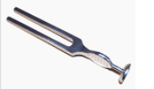
HAVs LOcHER Hands-on
Use a vibrating tuning fork to feel the vibrations travelling from a finger tip, up the hands and arms
Notes:
What do think about small amounts of vibration travelling through your fingers.
Now just imagine about using a hand-held powered tool; then imagine, if you were to use the tool for day-in-day-out for just 30 minutes daily.
Damage from exposure to vibration could be imagined like muscles, blood vessels, and nerves being put in a food processor to get mashed up slowly. So, do not ignore vibration exposure.
Do you think that you could suffer severely from the exposure to vibration?

Slide 12
AM I at Risk of Hand-Arm Vibration Exposure?

Slide 13
Powered Hand-Held Tools Commonly associated with HAV exposure If you use any of these?
Chain saws | Concreate or road breakers | Cut-off saws for metals and stones
Hammer drills and jigsaws | Grinders, disc cutters | Impact wrenches
Needle guns, scalers, scabblers | Pedestal grinders | Polishers
Power hammers, chisels | Power sander, brush cutters, strimmers | High-powered lawn mowers, hedge trimmers
Not an all inclusive list
Notes:
No notes

Slide 14
Which Jobs are likely to Create Risks? If you work in anyone of these sectors and use powered hand-held tool?
Construction | Construction Renovations | Engineering
Forestry | Foundry | Motor vehicles manufacture/repair
Grounds Maintenance (parks, gardens, farms, verges etc) | Ship building/repair | Utilities (gas, water, electricity, communications etc)
Not an all inclusive list
Notes:
No notes

Slide 15
Rules of Thumb to Identify exposure to HAV Risks
1. Rotary tool use – exceeds 1 hour of trigger time/day
2. Hammer-action tool use – exceeds 15 minutes of trigger time/day
3. Modern low vibration designs in good condition with well trained operators, and 1 and 2 above apply
4. Manually-held vibrating workpieces used
5. Anyone in your work area has early signs and symptoms of hand-arm vibration exposure
Notes:
No notes

Slide 16
What should be done to reduce Risks?

Slide 17
What should Your Employer DO?
Comply with the requirements of the Control of Vibration at Work Regulations
It means:
Identify tools and tasks causing the vibration exposure
Identify who is exposed, to what levels and for how long
Find out what can be done to eliminate vibration at source
Identify what control measures are needed, if exposure can not be eliminated
Put-in place control measures (those needed/identified by the assessment)
Provide information, instruction, training and supervision for correct use of tools
Correctly and regularly maintain tools
Provide health checks for early detection of vibration exposure damage
Also, consult employees/their representatives
Notes:
Risk assessment. This will include determining whether vibration exposure limits will be exceeded – the Exposure action value (EAV) = 2.5 m/s² A(8); Exposure limit value (ELV) = 5.0 m/s² A(8). You do not have to know any of these values. It is for your employer take the responsibility.
Identifying steps for preventing or controlling risks
Putting them in place before work starts
Providing information, instruction and training for correct use
Maintaining control measures in good working order
Providing PPE where its is necessary
Preparing for emergencies
Health surveillance – this is critical for HAVS as the symptoms in some individuals can progress rapidly to disabling levels. It is therefore vital that health surveillance is in place to identify symptoms as early as possible so that additional controls can be put in place to prevent progression of the symptoms.

Slide 18
What Should I do? - 1
Test out your work, using the “Rules of Thumb” below to understand vibration related problems at your workplace
1. Rotary tools use – exceeds 1 hour of trigger time/day
2. Hammer-action tool use – exceeds 15 minutes of trigger time/day
3. Modern low vibration designs in good condition in regular use by well trained operators
4. Manually-held vibrating workpieces used
5. Someone (or more) at the workplace has early signs and symptoms of hand-arm vibration exposure
Notes:
Test out your work using the “rules of Thumb”

Slide 19
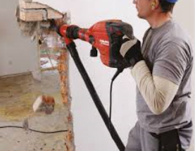
What Should I do? - 2
Avoiding or minimising the use of high vibration tools
Ask questions like:
(i) Why should I use a hand-held powered Jack hammer for the job?
(ii) Why can’t we use a machine mounted Jack hammer?
(iii) Why can’t we look at HSE’s
Vibration Solution Handbook for alternatives
Notes:
No Notes

Slide 20
What Should I do? - 3
Strictly observing Exposure time and tool use/trigger times determined by your employer
Don’t take short cuts to finish the job quickly and exceed the trigger time
Always, remember, it is your health
Notes:
The employer should ALWAYS look to reduce the vibration levels first before moving on to reducing the exposure duration/trigger time.
Elimination of the process counts as reducing the vibration exposure.
Having said that, if your employer half the vibration magnitude (level), but the tool is not efficient at doing the job, so, it takes 4 times longer to do the same work. Then the overall exposure has not changed.
It is always productive and safer to eliminate the vibration at source. The law requires that employers look at this option before controlling the exposure to vibration.

Slide 21
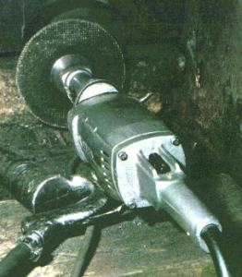
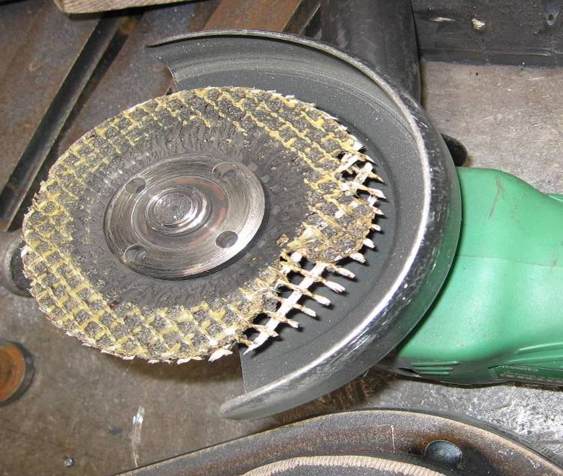
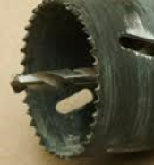
What should I do? - 4
Not using blunt, worn out, damaged or unmaintained tool
Notes:
No Notes

Slide 22
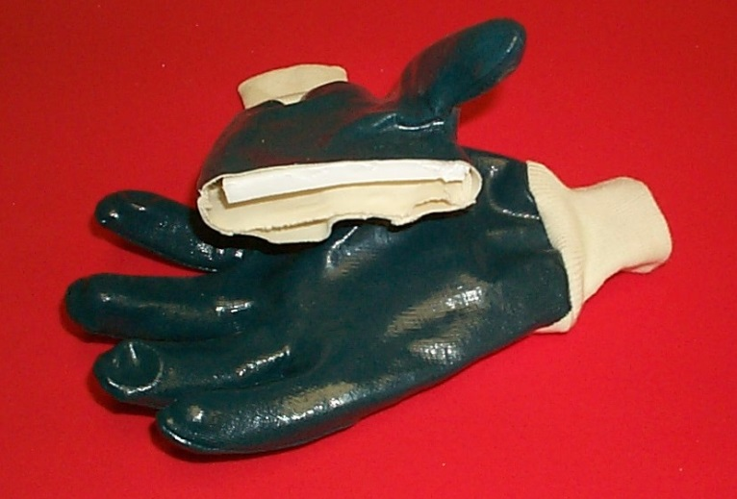
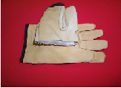
What Should I do? - 5
Not relying on “antivibration” gloves – (found to be ineffective by HSE)
Keeping hands warm in cold months using warm gloves
Notes:
No Notes

Slide 23
What Should I do? - 6
Not dismissing any early signs of the effects of HAV
(e.g. Tingling, numbing, pins and needles, and/or wrist pain)
Notes:
This images shows whitish finger tip, indicating damage caused by exposure to hand arm vibration

Slide 24
Summary
HAV comes from the use of hand-held, hand-guided and hand-fed power tools
Vibration is transmitted to the hands, wrists and arms
It can cause painful and disabling disorders of the fingers, wrists, arms, blood vessels, nerves and joints
Your employer need to:
Assess the risk of exposure to HAV
Find out what can be done to eliminate vibration at source
Identify what controls measures are needed
Put control measures in place and make sure they are used correctly
You need to:
Co-operate with your employer to achieve adequate control every time
Notes:
No Notes

Slide 25
Don’t become a Victim of Hand-Arm Vibration related disease
Questions
For the questions in the following slides, select either TRUE or FALSE answer
Please remember, if a question is answered incorrectly, you will be taken to the slide where correct answer is explained. After reading the correct answer, return to the question and tick the correct answer and move on to the next question.
When you have completed the module -
You are likely to get a certificate for completing this module. You may place it in your progression assessment/employment folder.
Notes:
No Notes

Slide 26
Question 1- Hand-Arm Vibration
1. Regularly using hand-held tools like manual hammers is likely to cause Hand Arm Vibration damage.
True
False

Slide 27
Question 2 - Hand-Arm Vibration
1. Exposure to excessive Hand-Arm vibration (HAV) could be easily caused by hand-held tools like manual hammers.
2. Regular long-term use of hand-held powered road-breaking tools are unlikely to cause permanent damage to hands.
True
False
Notes:
It depends upon on the amount of exposure. An A(8) of less than 1 m/s2 A(8) is unlikely to result in ill health.

Slide 28
Question 3 - Hand-Arm Vibration
1. Exposure to excessive Hand-Arm vibration (HAV) could be easily caused by hand-held tools like manual hammers.
2. Exposure to HAV caused by powered hand held tools do not cause permanent damage to hands.
3. Powered hand-held tools are the only cause for exposure to HAV.
True
False

Slide 29
Question 4 - Hand-Arm Vibration
1. Exposure to excessive Hand-Arm vibration (HAV) could be easily caused by hand-held tools like manual hammers.
2. Exposure to HAV caused by powered hand held tools do not cause permanent damage to hands.
3. Powered hand-held tool are the only cause for exposure to HAV.
4. Manually holding or feeding vibrating workpieces isn’t a problem for HAV exposure.
True
False

Slide 30
Question 5 - Hand-Arm Vibration
1. Exposure to excessive Hand-Arm vibration (HAV) could be easily caused by hand-held tools like manual hammers.
2. Exposure to HAV caused by powered hand held tools do not cause permanent damage to hands.
3. Powered hand-held tool are the only cause for exposure to HAV.
4. Manually holding or feeding vibrating work pieces aren’t problem form HAV exposure.
5. The Control of Vibration at Work Regulations don’t place duties on employers to eliminate HAV at source, where it is reasonably practical.
True
False

Slide 31
Question 6 - Hand-Arm Vibration
1. Exposure to excessive Hand-Arm vibration (HAV) could be easily caused by hand-held tools like manual hammers.
2. Exposure to HAV caused by powered hand held tools do not cause permanent damage to hands.
3. Powered hand-held tool are the only cause for exposure to HAV.
4. Manually holding or feeding vibrating work pieces aren’t problem form HAV exposure.
5. The Control of Vibration at Work Regulations don’t place duties on employers to eliminate HAV at source, where it is reasonably practical.
6. Employers don’t have any legal duties to consult their employees or their representatives on matters affecting their health and safety at their workplace.
True
False

Slide 32
Question 7- Hand-Arm Vibration
1. Exposure to excessive Hand-Arm vibration (HAV) could be easily caused by hand-held tools like manual hammers.
2. Exposure to HAV caused by powered hand held tools do not cause permanent damage to hands.
3. Powered hand-held tool are the only cause for exposure to HAV.
4. Manually holding or feeding vibrating work pieces aren’t problem form HAV exposure.
5. The Control of Vibration at Work Regulations don’t place duties on employers to eliminate HAV at source, where it is reasonably practical.
6. Employer don’t have a legal duty to consult their employees or their representatives on matters affecting their health and safety at their workplace.
7. Rules of Thumb (vibration) are a waste of time for checking whether tools /work activities could cause HAV to myself or other employees.
True
False

Slide 33
Question 8 - Hand-Arm Vibration
1. Exposure to excessive Hand-Arm vibration (HAV) could be easily caused by hand-held tools like manual hammers.
2. Exposure to HAV caused by powered hand held tools do not cause permanent damage to hands.
3. Powered hand-held tool are the only cause for exposure to HAV.
4. Manually holding or feeding vibrating work pieces aren’t problem form HAV exposure.
5. The Control of Vibration at Work Regulations don’t place duties on employers to eliminate HAV at source, where it is reasonably practical.
6. Employer don’t have a legal duty to consult their employees or their representatives on matters affecting their health and safety at their workplace.
7. Rules of Thumb (vibration) is a waste of time for checking whether the tools /work activities could cause HAV to myself or other employees.
8. I strictly follow the vibrating tool use and trigger time. It just a time waster.
True
False

Slide 34
Question 9 - Hand-Arm Vibration
1. Exposure to excessive Hand-Arm vibration (HAV) could be easily caused by hand-held tools like manual hammers.
2. Exposure to HAV caused by powered hand held tools do not cause permanent damage to hands.
3. Powered hand-held tool are the only cause for exposure to HAV.
4. Manually holding or feeding vibrating work pieces aren’t problem form HAV exposure.
5. The Control of Vibration at Work Regulations don’t place duties on employers to eliminate HAV at source, where it is reasonably practical.
6. Employer don’t have a legal duty to consult their employees or their representatives on matters affecting their health and safety at their workplace.
7. Rules of Thumb (vibration) is a waste of time for checking whether the tools /work activities could cause HAV to myself or other employees.
8. I don’t need to strictly follow the vibrating tool use and trigger time. It just a time waster.
9. Wearing anti-vibrations gloves, is adequate enough to protect me from HAV exposure to powered hand-held tools.
True
False

Slide 35
Question 10 - Hand-Arm Vibration
1. Exposure to excessive Hand-Arm vibration (HAV) could be easily caused by hand-held tools like manual hammers.
2. Exposure to HAV caused by powered hand held tools do not cause permanent damage to hands.
3. Powered hand-held tool are the only cause for exposure to HAV.
4. Manually holding or feeding vibrating work pieces aren’t problem form HAV exposure.
5. The Control of Vibration at Work Regulations don’t place duties on employers to eliminate HAV at source, where it is reasonably practical.
6. Employer don’t have a legal duty to consult their employees or their representatives on matters affecting their health and safety at their workplace.
7. Rules of Thumb (vibration) is a waste of time for checking whether the tools /work activities could cause HAV to myself or other employees.
8. I don’t need to strictly follow the vibrating tool use and trigger time. It just a time waster.
9. Wearing anti-vibrations gloves, is adequate enough to protect me from HAV exposure to powered hand-held tools.
10. Early signs, observed due to HAV exposure, are temporary. I can carry on using the tools caused the temporary symptoms. My body will carry out the natural repair, any way.
True
False

Slide 36
What is Hand-Arm Vibration?
Hand-Arm vibration (HAV) comes from the use of hand-held power tools
Vibration is transmitted to the hands, wrists and arms
It can cause painful and disabling disorders of the fingers, wrists, arms, blood vessels, nerves and joints
Back to
Question
Notes:
Many people at work are exposed to levels of hand-arm vibration, which put their health at risk.
In order to protect workers health, the Control of Vibration at Work Regulations require employers to prevent or reduce the risk to their employees.
Exposure to vibrations created at work can cause vibration-related diseases.
We will have a look at them in a while.

Slide 37
Early Symptoms of Exposure to HAV 2
Early Signs and Symptoms
Tingling, numbness, pain, pin and needles
Distress, and sleep disturbance
Not being able to feel things with your fingers
Loss of strength and grip in your hands
In the cold and wet, the tips of your fingers going white, then red and being painful on recovery (vibration white finger)
Continuing to use hand-held tools at work
Numbness in hands becoming permanent
Won’t be able to feel fine things at all
Will have difficulty picking up small objects such as screws
The vibration white finger (VWF) attacks happens more frequently and affect more fingers
Back to question
Notes:
This slide tells you that if one keeps on ignoring the early signs and symptoms (they are bad enough), the disease will become permanent, as you have seen from picture C in slide 7.

Slide 38
Rules of Thumb to Identify exposure to HAV Risks
1. Rotary Tool use – exceeds 1 hour of trigger time/day
2. Hammer-action tool use – exceeds 15 minutes of trigger time/day
3. Modern low vibration designs in good condition with well trained operators, in regular use
4. Manually-held vibrating workpieces used
5. Anyone at the workplace has early signs and symptoms of hand-arm vibration exposure.
Back to Question
Notes:
This is not an exact science, but a tool

Slide 39
Rules of Thumb to Identify exposure to HAV Risks
1. Rotary Tool use – exceeds 1 hour of trigger time/day
2. Hammer-action tool use – exceeds 15 minutes of trigger time/day
3. Modern low vibration designs in good condition with well trained operators, in regular use
4. Manually-held vibrating workpieces used
5. Anyone at the workplace has early signs and symptoms of hand-arm vibration exposure.
Back to Question
Notes:
This is not an exact science, but a tool

Slide 40
What should Your Employer DO?
Comply with the requirements of the Control of Vibration at Work Regulations
Identify tool and tasks causing the vibration exposure
Identify who is exposed, to what levels and for how long
Find out what can be done to eliminate vibration at source
Identify what control measures are needed
Put-in place control measures
Provide information, instruction, training and supervision for correct use of tools
Correctly and regularly maintain tools
Provide health checks for early detection of vibration exposure damage
Also, Consult employees or their representatives on matters affecting their health and safety
Back to Question
Notes:
Remember the 7 common theme that is present in most laws.
Risk assessment
Identifying steps for preventing or controlling risks
Putting them in place before work starts
Providing information, instruction and training for correct use
Maintaining control measures in good working order
Providing PPE where its is necessary
Preparing for emergencies

Slide 41
What should Your Employer DO?
Comply with the requirements of the Control of Vibration at Work Regulations
Identify tool and tasks causing the vibration exposure
Identify who is exposed, to what levels and for how long
Find out what can be done to eliminate vibration at source
Identify what control measures are needed
Put-in place control measures
Provide information, instruction, training and supervision for correct use of tools
Correctly and regularly maintain tools
Provide health checks for early detection of vibration exposure damage
Also, Consult employees or their representatives on matters affecting their health and safety
Back to
Question
Notes:
Remember the 7 common theme that is present in most laws.
Risk assessment
Identifying steps for preventing or controlling risks
Putting them in place before work starts
Providing information, instruction and training for correct use
Maintaining control measures in good working order
Providing PPE where its is necessary
Preparing for emergencies

Slide 42
What Should I do?
Use the “Rules of Thumb” to understand vibration related problems at your workplace
1. Rotary Tool use – exceeds 1 hour of trigger time/day
2. Hammer-action tool use – exceeds 15 minutes of trigger time/day
3. Modern low vibration designs in good condition with well trained operators, in regular use
4. Manually-held vibrating workpieces used
5. Someone (or more) at the workplace has early signs and symptoms of hand-arm vibration exposure
Back to Question

Slide 43
What Should I do?
Strictly observing tool use/trigger times determined by your employer
Don’t take short cuts to finish the job quickly and exceed the trigger time.
Always, remember, it is your health
Back to Question

Slide 44
What Should I do?
Not relying on “antivibration” gloves – (found to be ineffective by HSE)
Keeping hands warm in cold months using warm gloves
Back to Question

Slide 45
What Should I do?
Not dismissing any early signs of the effects of HAV
(e.g. Tingling, numbing, pins and needles, wrist pain)
Back to Question

Slide 46
Note to Lecturers
For SGUK certificate Word template please contact
contact@safetygroupsuk.org.uk
Notes:
Assignment Activities (optional) (learning outcomes – How to identify hazards, control measures and put them in place before work starts)
(i) (team work or individual assignment):
Explain the key features of the COSHH regulations and apply them in selected areas of their work activities (for safe working with a hazardous substance.)
(they will explain the six essentials steps and the facts associated with them and apply them in their selected work activity example. To help them, they can draw information in INDG 136 (see next slide) and the relevant HSE’s COSHH ESSENTIAL DIRECT ADVICE SHEETS to prepare an all round and an excellent assignment and provide a list of references, safety labels on containers and safety data sheets relevant to the substance being looked at.)
Describe the methods used for identifying the hazardous properties of a manufactured product containing hazardous substances (for example concentrated metal working fluid.)
(product labels, safety data sheets, Hazards warning signs and HSE’s COSHH ESEENTIALS DIRECT ADVICE SHEETS.)
If a worker has suffered work-related asthma due to exposure to a hazardous substance at work, is this reportable to the Health and Safety Executive (HSE) under the RIDDOR regulations? If yes, who should report this and how will it be reported?
(Yes, employer or their appointed person; online to a central point using a prescribed on-line form. More information can be seen in HSE website - https://www.hse.gov.uk/riddor/report.htm)

Slide 47
Notes:
No Notes for this slide

