Slide 1
Protect Your Precious Lungs - Every Breath Counts
Notes:
Summary (for presenters)
This short practical, interactive, and emotionally engaging PowerPoint (PPT) presentation put across the reasons and importance for looking after your lungs health at work.
Exposure to dusts, vapours and gases contaminated air at work can result in lung disease. Its consequences include many thousands of early deaths each year. Dusts at work cause significant amount of work-related lung disease and early deaths.
What do I need to use this PPT presentation?)
Access to internet and YouTube.
(for practical, if being under taken)
1 x tealight, 1 x a bottle jar, 1 x an aluminium foil wrapped carboard, 1 x a box of match and sealed tubes containing welding dust (mimic with ground coffee granules), wood dust (mimic with ground corn flakes) and stone dust (mimic with flour and fine sand mixed together).
Further details on how to demonstrate the candle experiment (shown in this PPT) can be found in the “Confined Spaces” PPT
How long will it take to Present this PPT?
About 10 minutes, excluding LOcHER hands on activities.
LOcHER hands on (optional) (intended to reinforce understanding and encourage exposure control actions)
1. After listening to Professor Fishwick and Stonemason Terry, invite your audience to recall what types of lung disease can be caused when people at work are exposed to air contaminated with:
Welding fume, Stone dust, Industrial grade flour dust, Enzyme based washing powders, Asbestos dust, Soldering fume and Wood dust.
2. (optional) Invite your audience to access LOcHER project website look at examples created by apprentices in further education colleges, as well as workers and managers in industry. See Praise section of LOcHER pages, to look how their achievements were celebrated and recognised.
3. Encourage your audience to create their own ways (e.g. short films, posters, poems, music etc) to explain their understanding/thinking about the importance of protecting their precious lungs at work. When created please let us have it. Send them to locher@hse.gov.uk

Slide 2
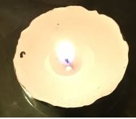
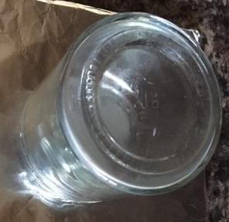
Protect your Precious Lungs Every Breath Counts
A lit candle
Just enclosed in a jar
A few seconds later
Notes:
All of us need fuel (food) to burn to stay alive and the fuel needs oxygen to burn and release the energy we need. Remember the “Fire Triangle”, similar – fuel (food), oxygen and source of heat (digestive system and enzymes)
The lit candle needs oxygen to burn and it will stay alight if it has access to that oxygen.
When the oxygen is cut off by covering it with a jar, the candle goes out very quickly.
Our bodies are the same. We need the precious oxygen that we breathe. Any disease of the lungs may prevent us from getting hold of sufficient amount of that precious oxygen.

Slide 3
A sad part of health and safety
Each year
Approx. 12,000 lung disease related deaths
About 18,000 new cases of lung related problems
Notes:
Health and Safety Executive (HSE) tell us that nearly 12000 lung disease deaths each year are linked to past exposure to dusts and other hazardous substances at work. This is equivalent to nearly 200 double-decker bus loads of people being taken away by the undertakers to lay them to RIP.
HSE also tell us that each year nearly 18,000 workers report breathing or lung related problems caused or made worse by work. For you to think in practical terms, this is equivalent to about 300 double-decker buses with people in each seat.
So, you can appreciate why your lungs are so precious and every breath counts.

Slide 4
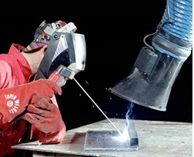
Protect your Precious Lungs Every Breath Counts
Would you lick dust off a welding table?
Notes:
Now then, would you ever consider or even imagine
Licking dust off a welding table
(For the Presenter: in your presentation session, you may have it on display a bowl of cornflakes, a pillow case and sealed tubes containing welding dust, wood dust and stone dust)

Slide 5
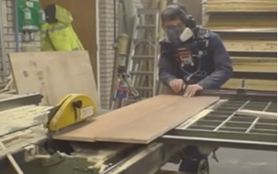
Protect your Precious Lungs Every Breath Counts
Would you sprinkle wood dust on your pillow?
Notes:
Now then, would you ever consider or imagine
Sprinkling wood dust on your pillow
(For the Presenter: in your presentation session, you may have it on display a bowl of cornflakes, a pillow case and sealed tubes containing welding dust, wood dust and stone dust)

Slide 6
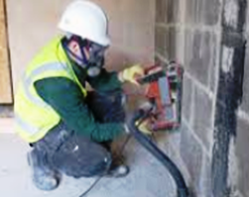
Protect your Precious Lungs Every Breath Counts
Would you sprinkle asbestos or silica dust
on your cornflakes
Notes:
Now then, would you ever consider or even imagine
Sprinkling asbestos or silica dust on your cornflakes
(For the Presenter: in your presentation session, you may have it on display a bowl of cornflakes, a pillow case and sealed tubes containing welding dust, wood dust and stone dust)

Slide 7
Protect your Precious Lungs Every Breath Counts
Do not breathe
X welding fume
X Metal Working Fluid mist
X paint Sprays
X silica, wood and asbestos dusts
Notes:
So, at work, you should not have to breathe things like
welding fume and diesel engine exhaust fume
Metal Working Fluid mist
Paint sprays
Cement, silica, wood, and asbestos dusts.
And, remember the law gives you protection.
Employers must:
Identify what hazardous substances are used at their work;
know the health risks associated with them; and,
put in place adequate exposure control measures so that you are prevented from breathing hazardous substances at work.
(You may change the list of substances to reflect your audience area(s) of concern, e.g. isocyanates in motor vehicle spray painting, foundry particles in foundries)

Slide 8
Protect your Precious Lungs Every Breath Counts
Just listen to Professor Fishwick
https://www.youtube.com/watch?v=cNy8Ba-rTAU
Notes:
Just listen to Professor Fishwick. He explains the dangers associated with breathing dusty air at work.
LOcHER hands on
(For the Presenter: you may seek feedback from your audience to know their extent of understanding and views on what they have heard and what would they do differently when they are at work next time.)
(About Professor Fishwick - He is a Consultant Respiratory Physician at the University Hospital in Sheffield and is involved in clinical research on work-related lung disease. In addition, he is an expert advisor to many bodies including the Health and Safety Executive.)

Slide 9
Protect your Precious Lungs Every Breath Counts
Listen to Stone Mason Terry’s
conversation with Professor Fishwick
https://www.youtube.com/watch?v=bPkRKoU9-qU
Notes:
This is a harrowing story and provides a powerful argument why you need to look after you precious lungs, when at work.
So, in summary,
Employers must
Identify what hazardous substances are used at their work,
know the health risks associated with them, and
put in place adequate exposure control measures so that you are prevented from breathing hazardous substances at work.
You (Employees) must
Undertake work as trained and instructed.
Keep this in mind all the time:
“everyone has the right to come home safe and well from their job.” HSE

